Slide 1
AWS Server Installation &
Configuration Guide

Slide 2
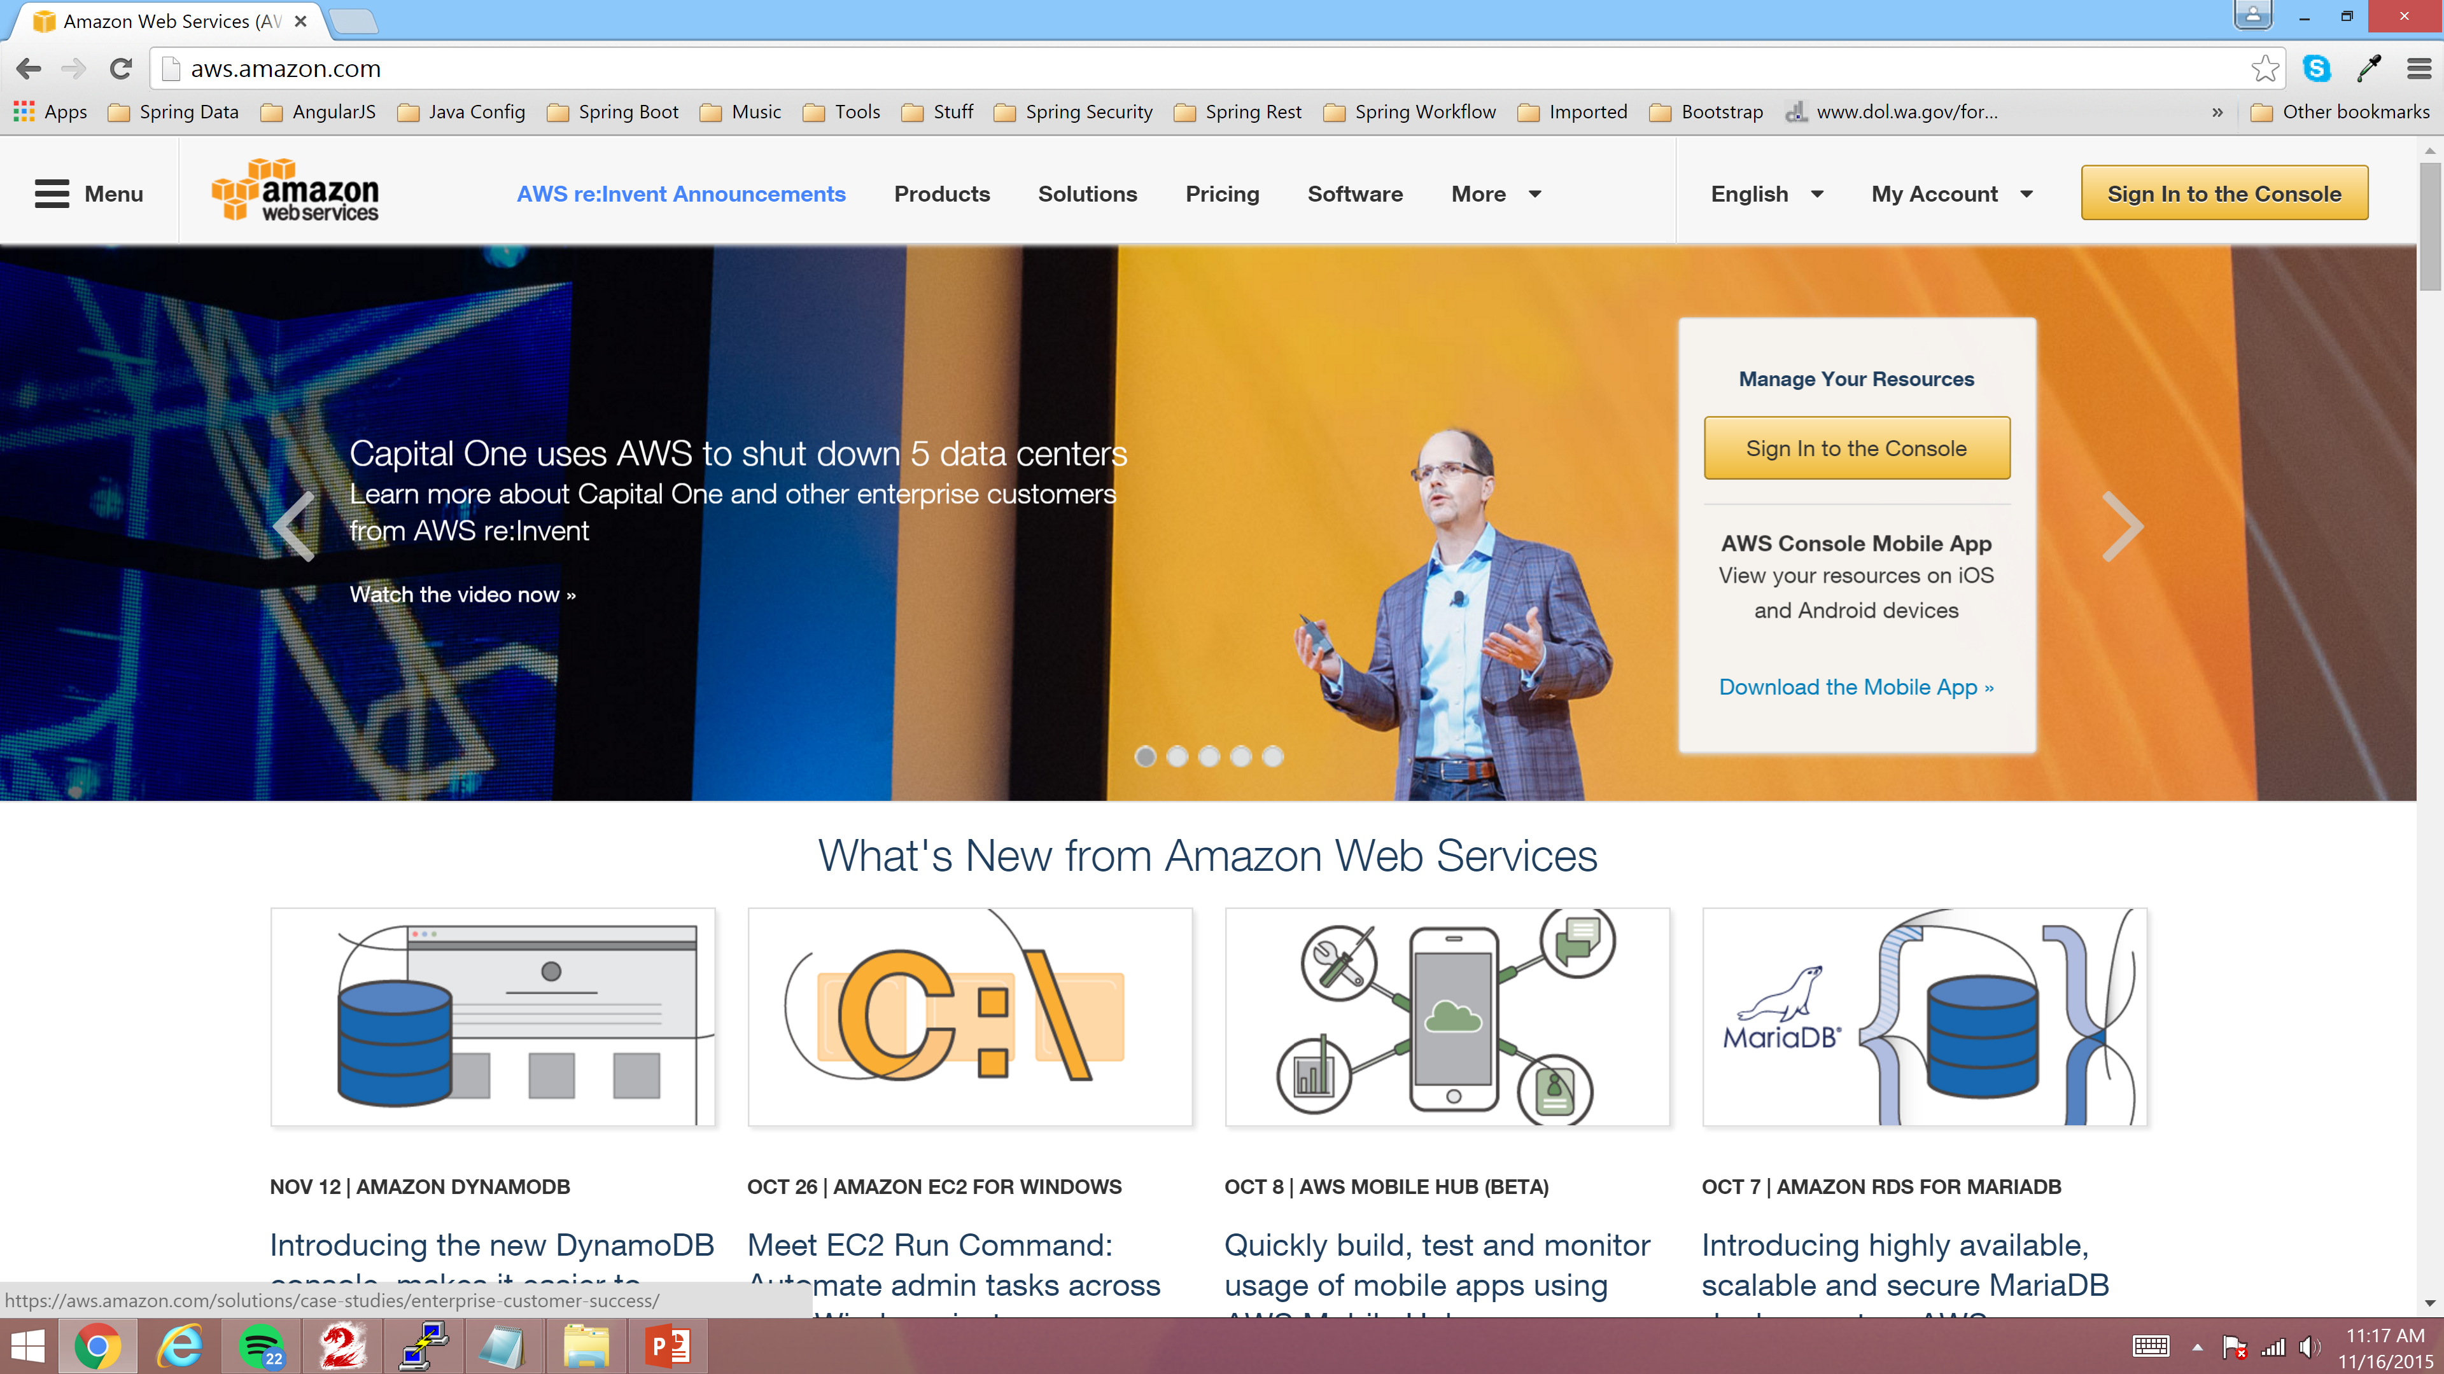
Login to the AWS Console
Navigate to http://aws.amazon.com with your Web Browser of choice and click “Sign in to the Console”

Slide 3
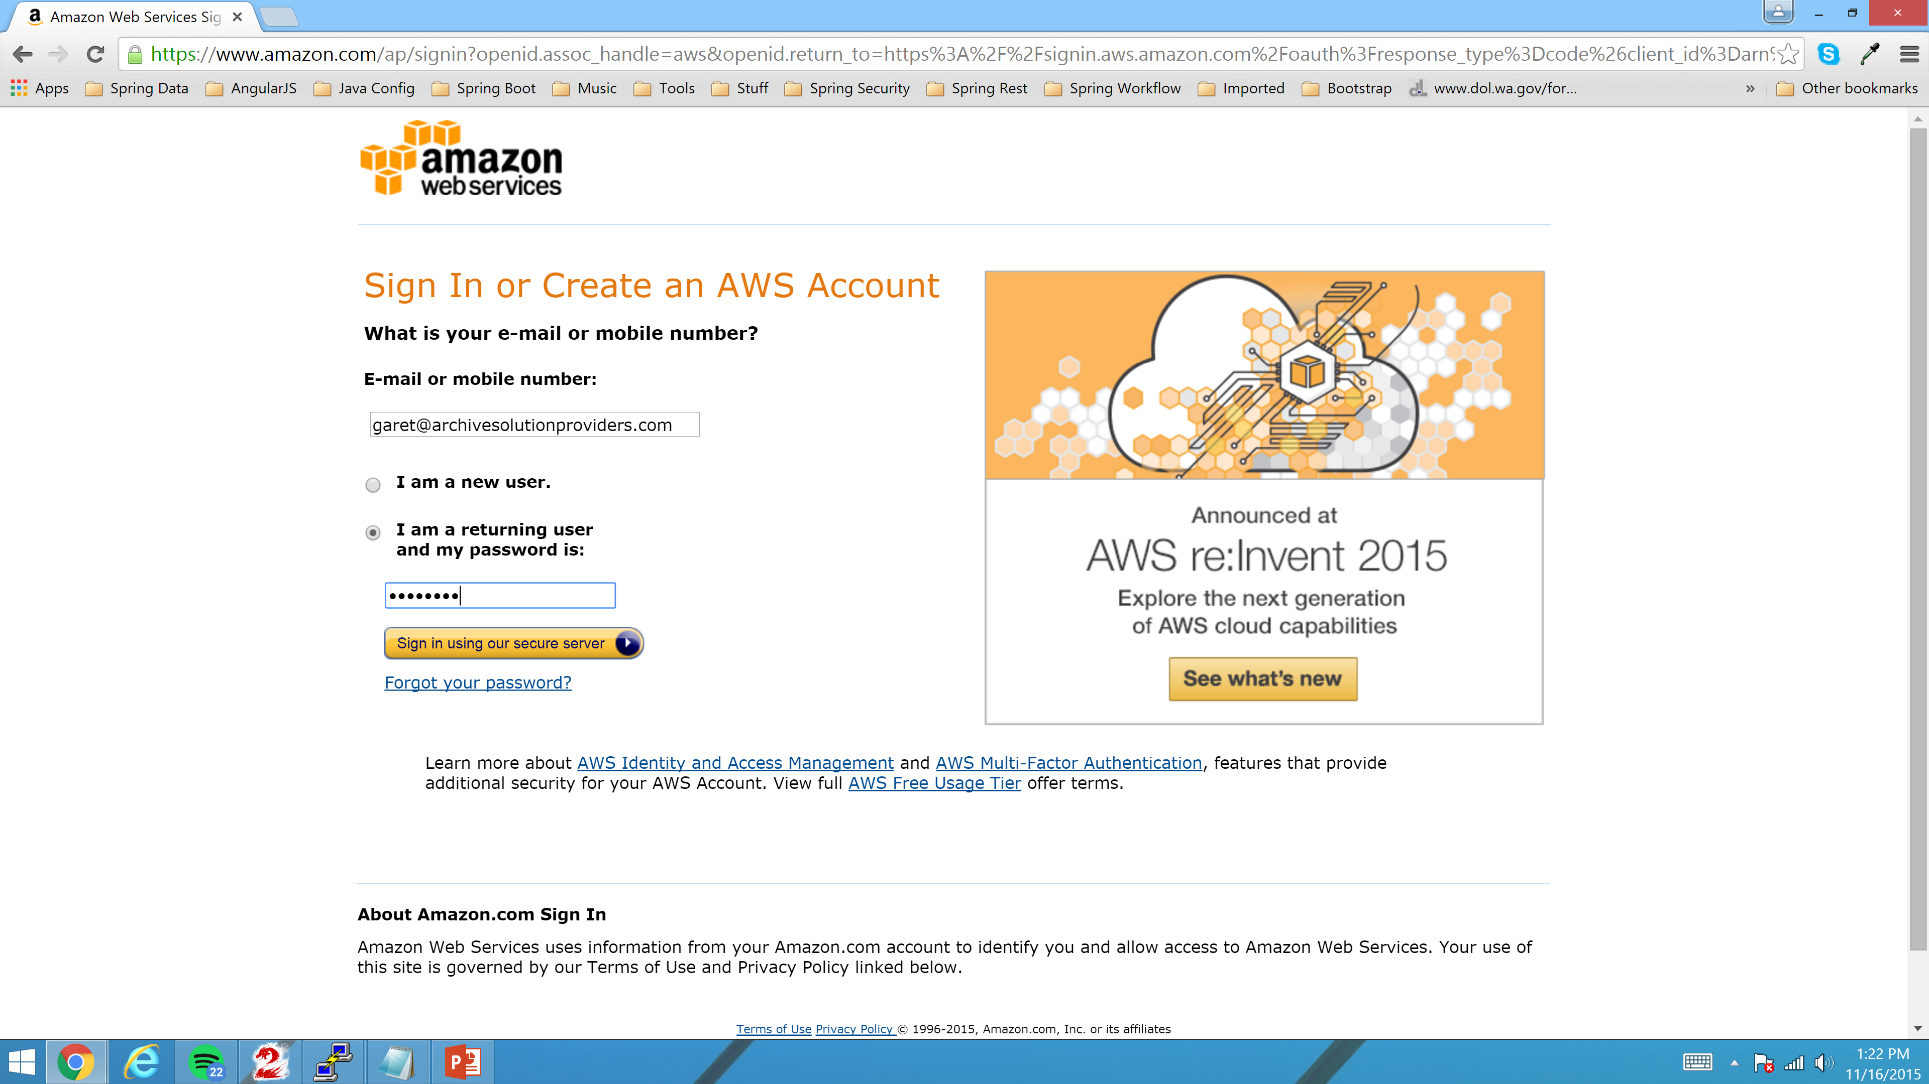
Signin as garet@archivesolutionproviders.com and click “Sign in using our secure server”

Slide 4
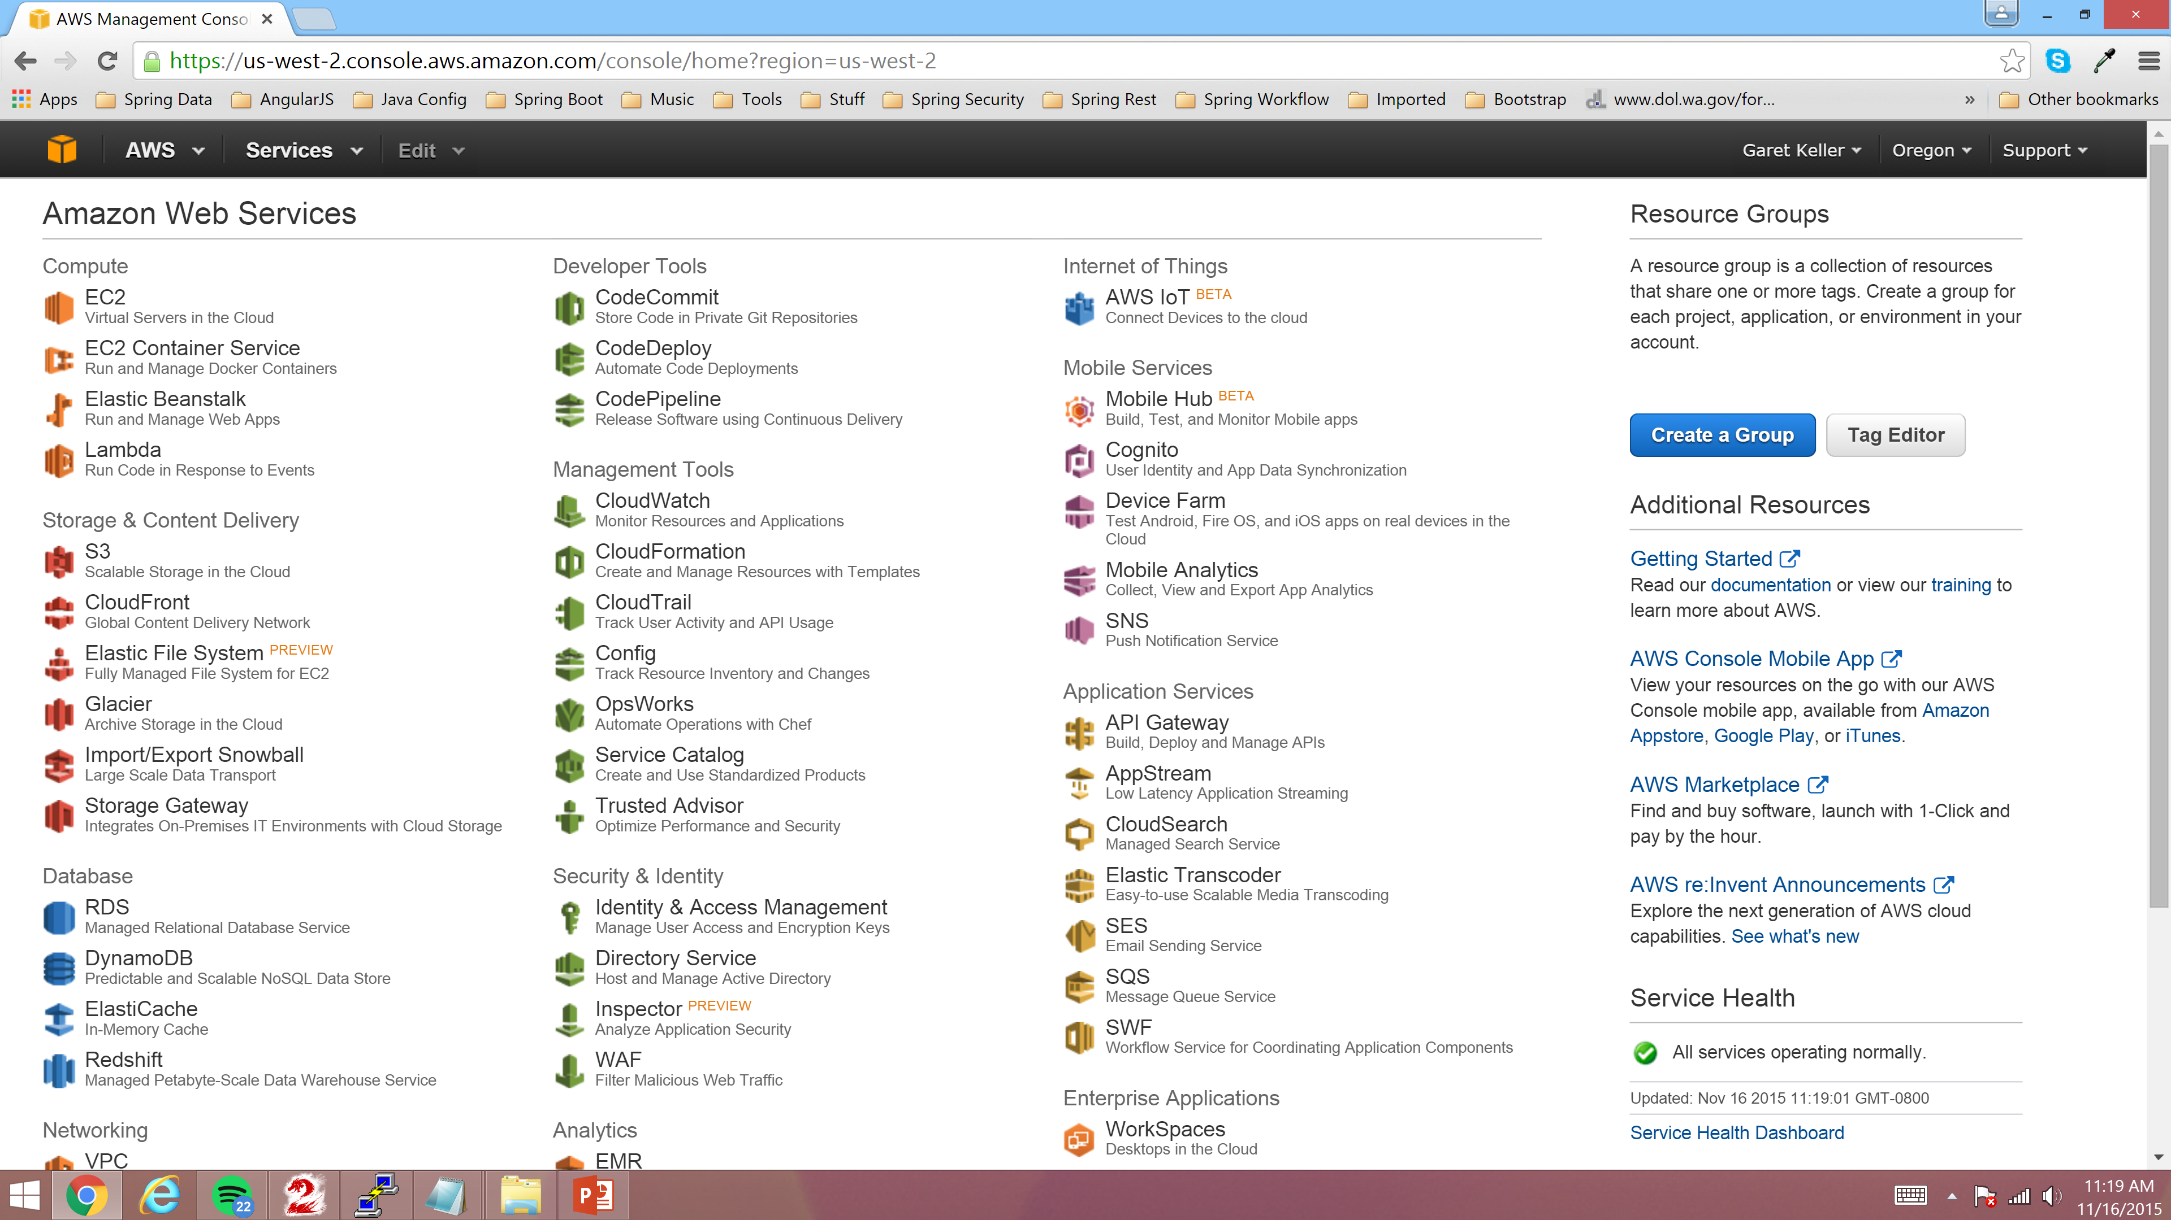
Navigate to EC2 – Click link “EC2” Virtual Servers in the Cloud

Slide 5
Create a new AWS Linux Server

Slide 6
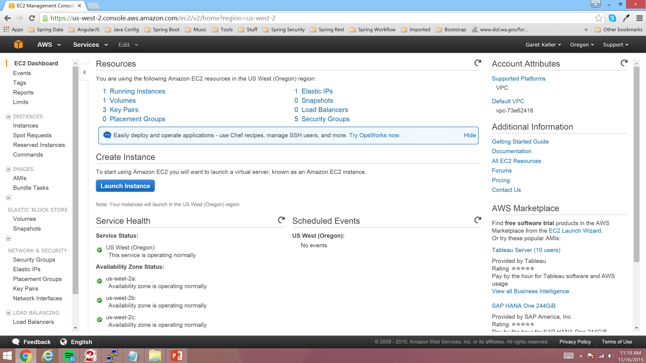
Click “Launch Instance” Link

Slide 7
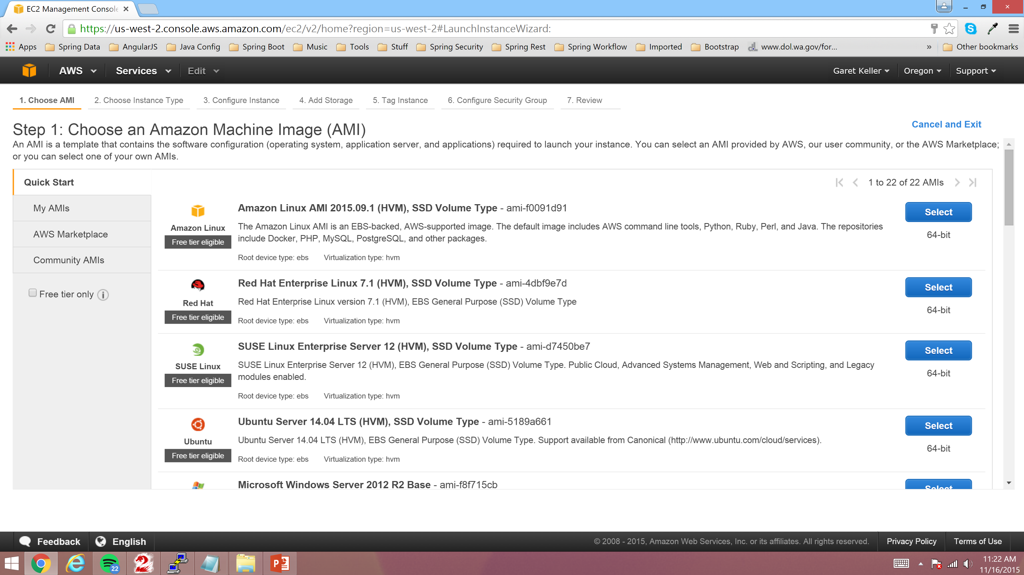
Click Amazon Linux AMI 64-bit Image “Select” Link

Slide 8
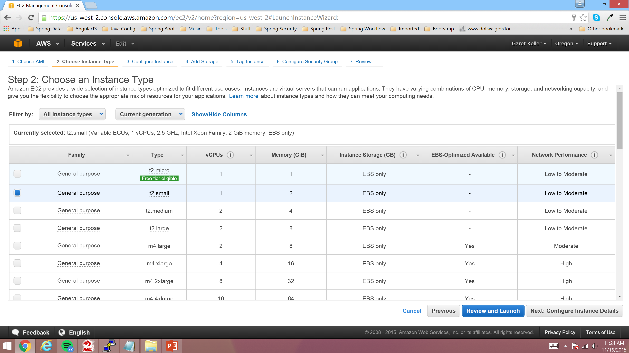
Select “t2.small” instance Type and click
“Next: Configure Instance Details”

Slide 9
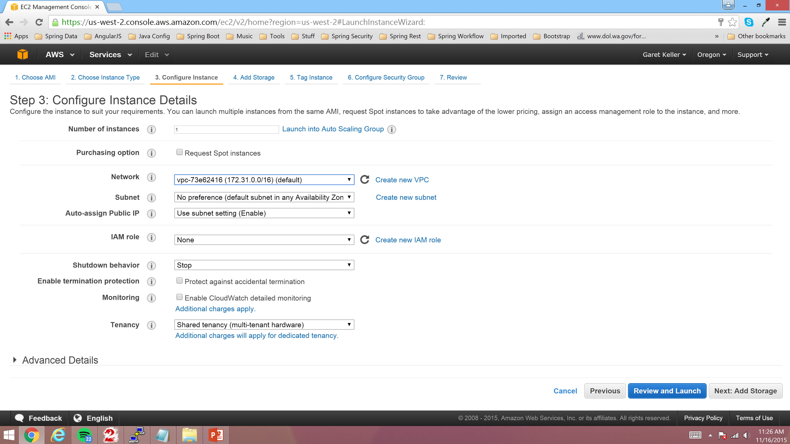
Click “Next: Add Storage”

Slide 10
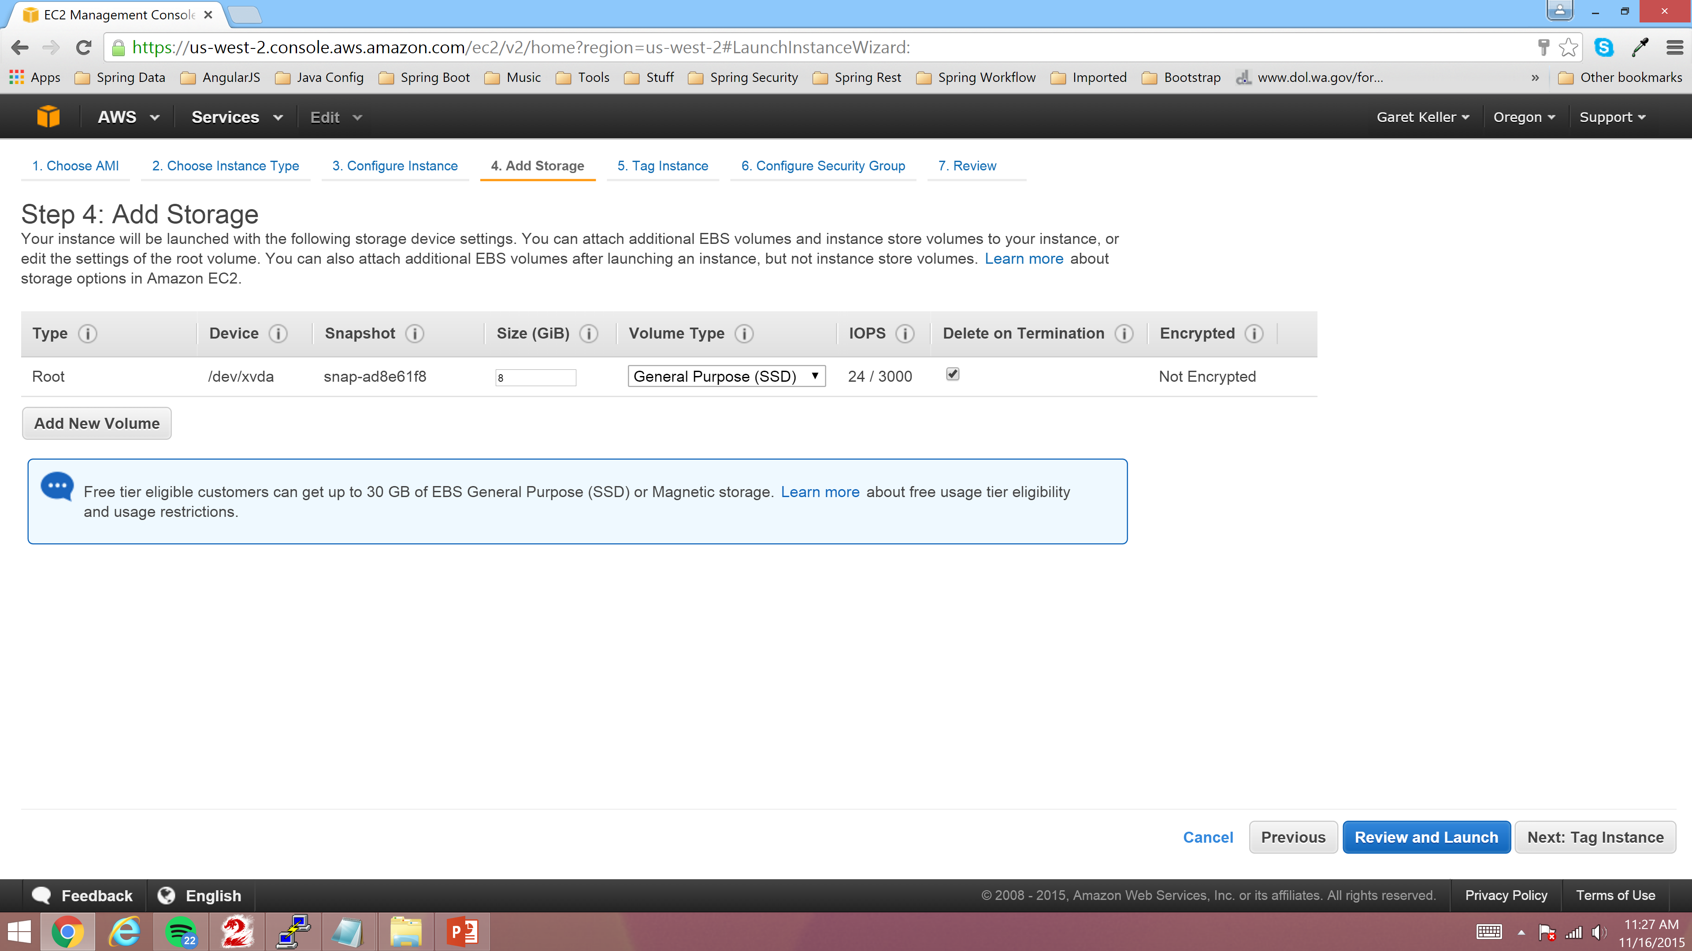
Click “Next: Tag Instance”

Slide 11
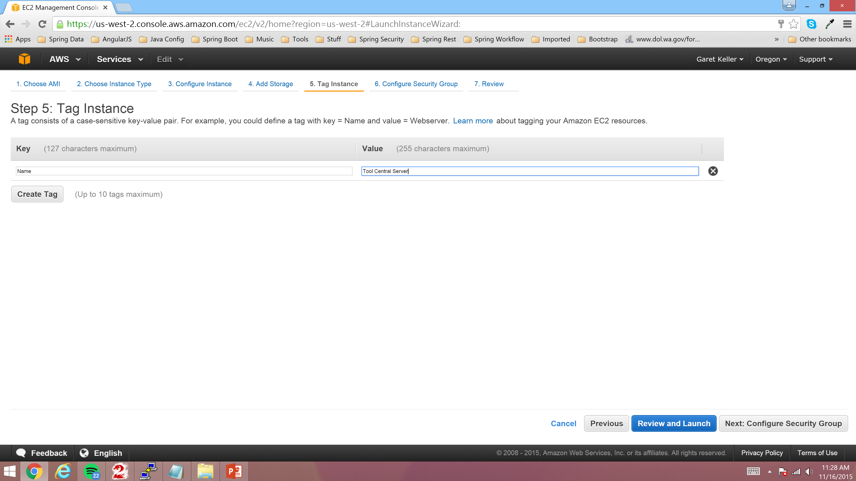
Enter Instance Name and click “Next: Configure Security Group”

Slide 12
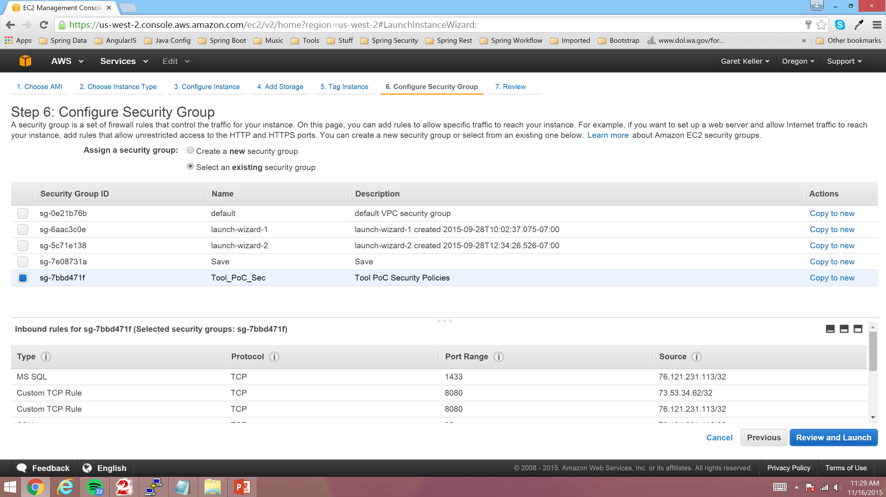
Select existing Security Group and click “Review and Launch”

Slide 13
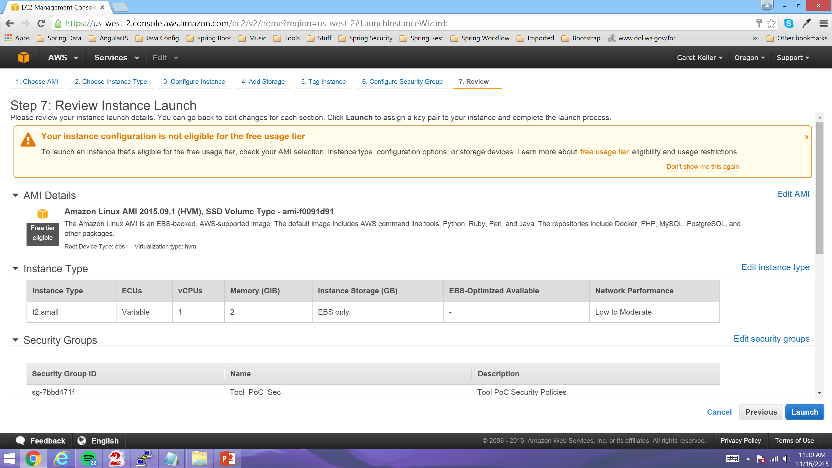
Review Defaults and if all looks good click “Launch”

Slide 14
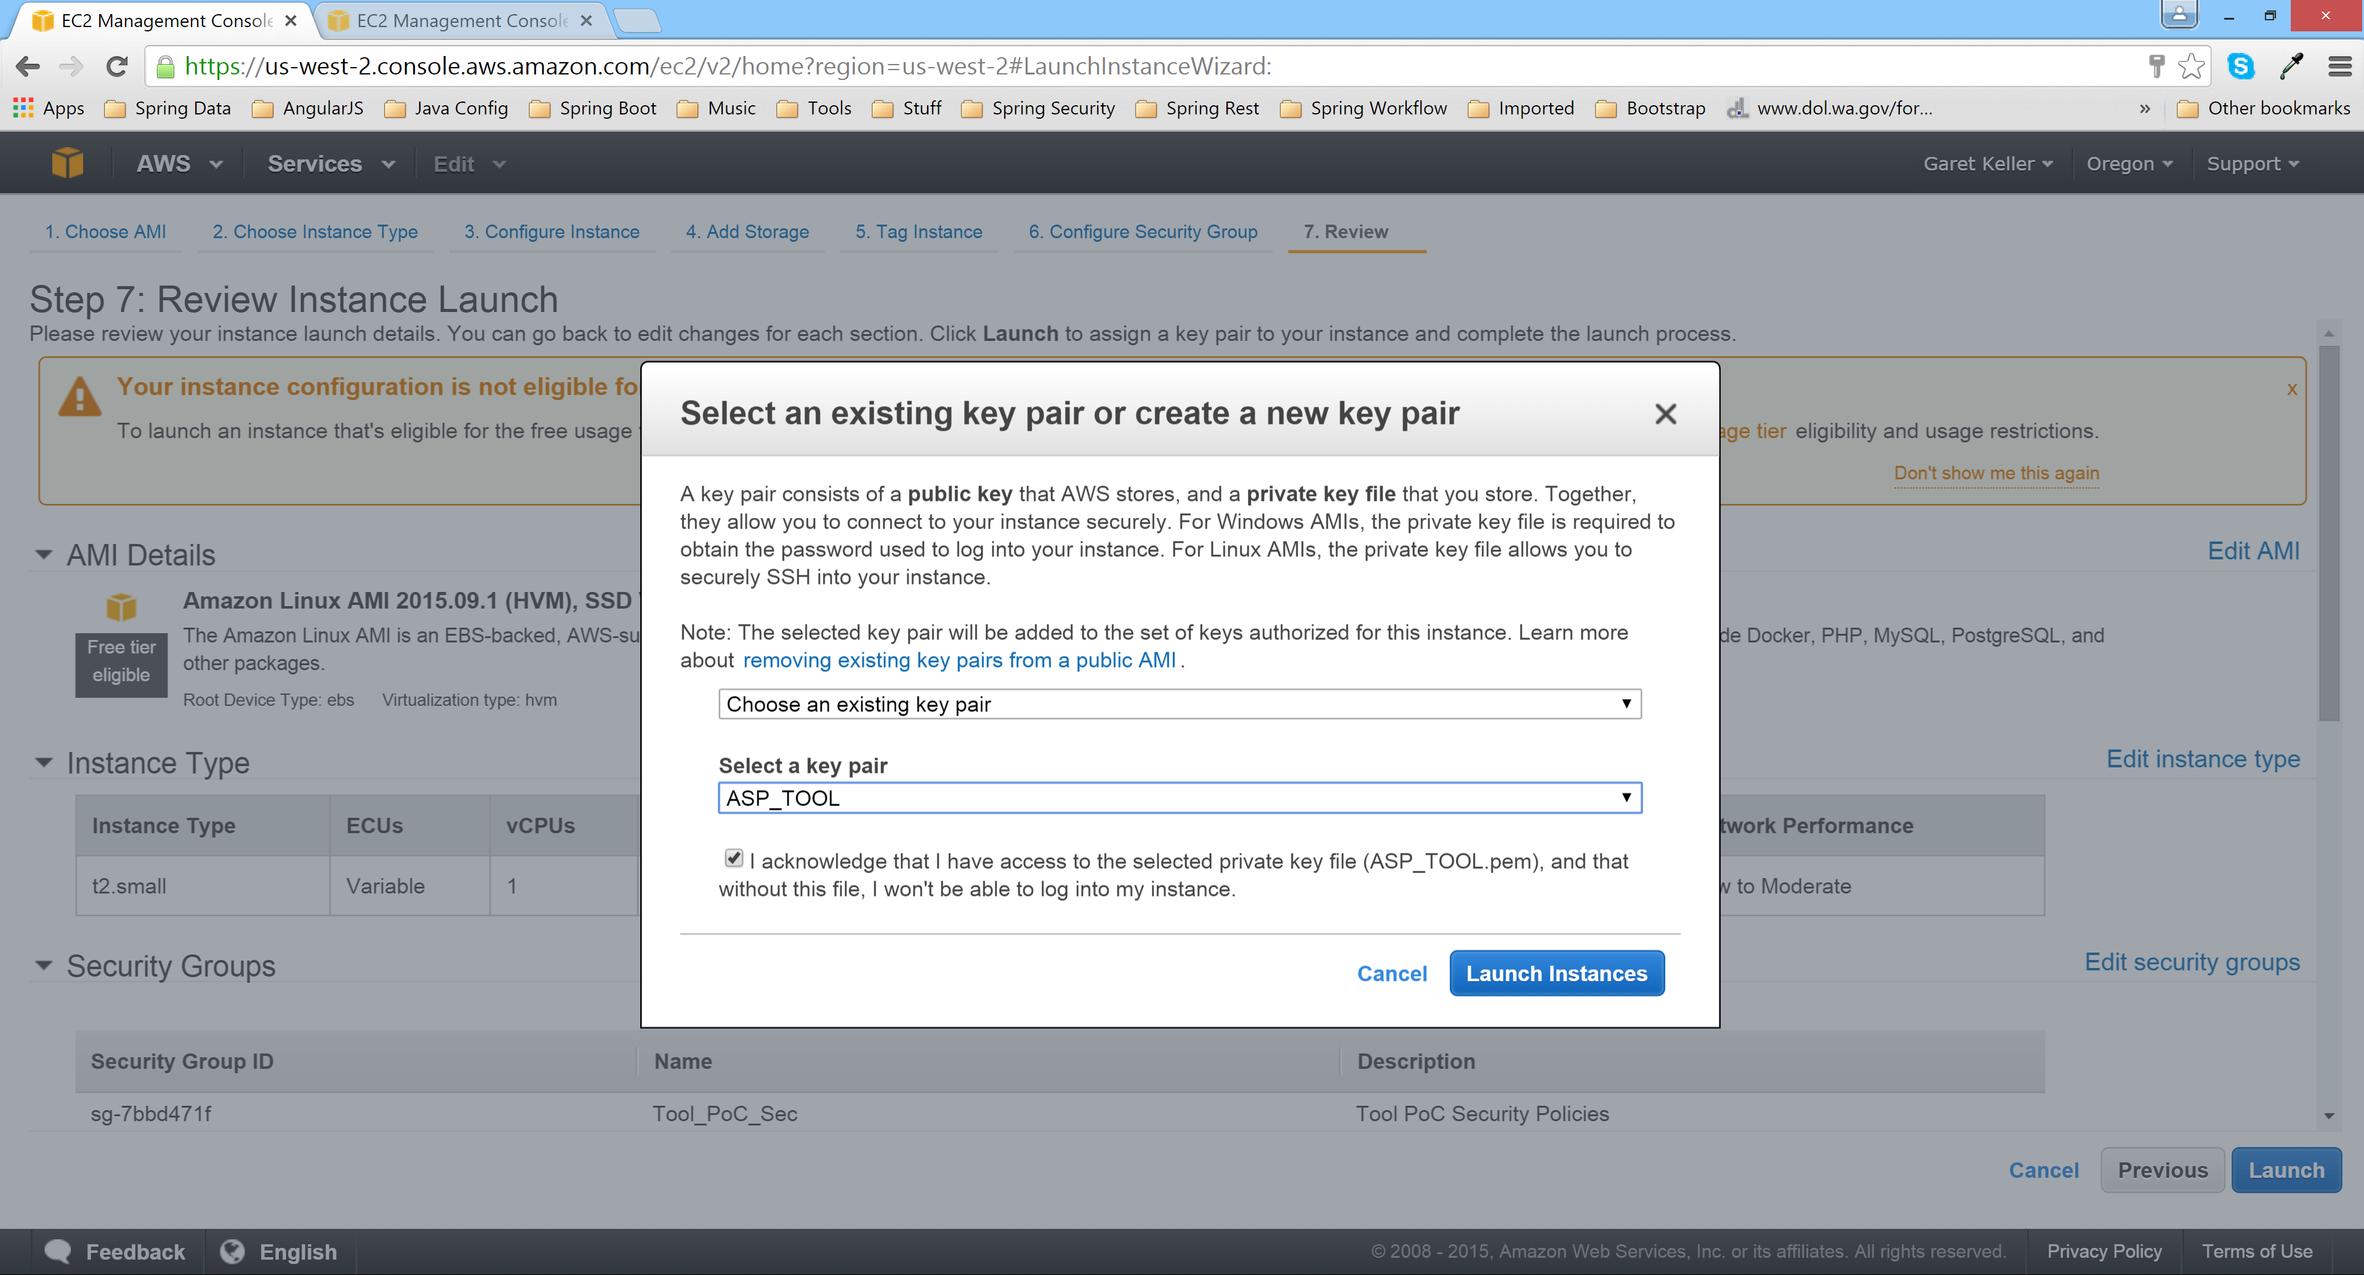
Select existing Security Key Pair, click the acknowledgement box and then click “Launch Instances”

Slide 15
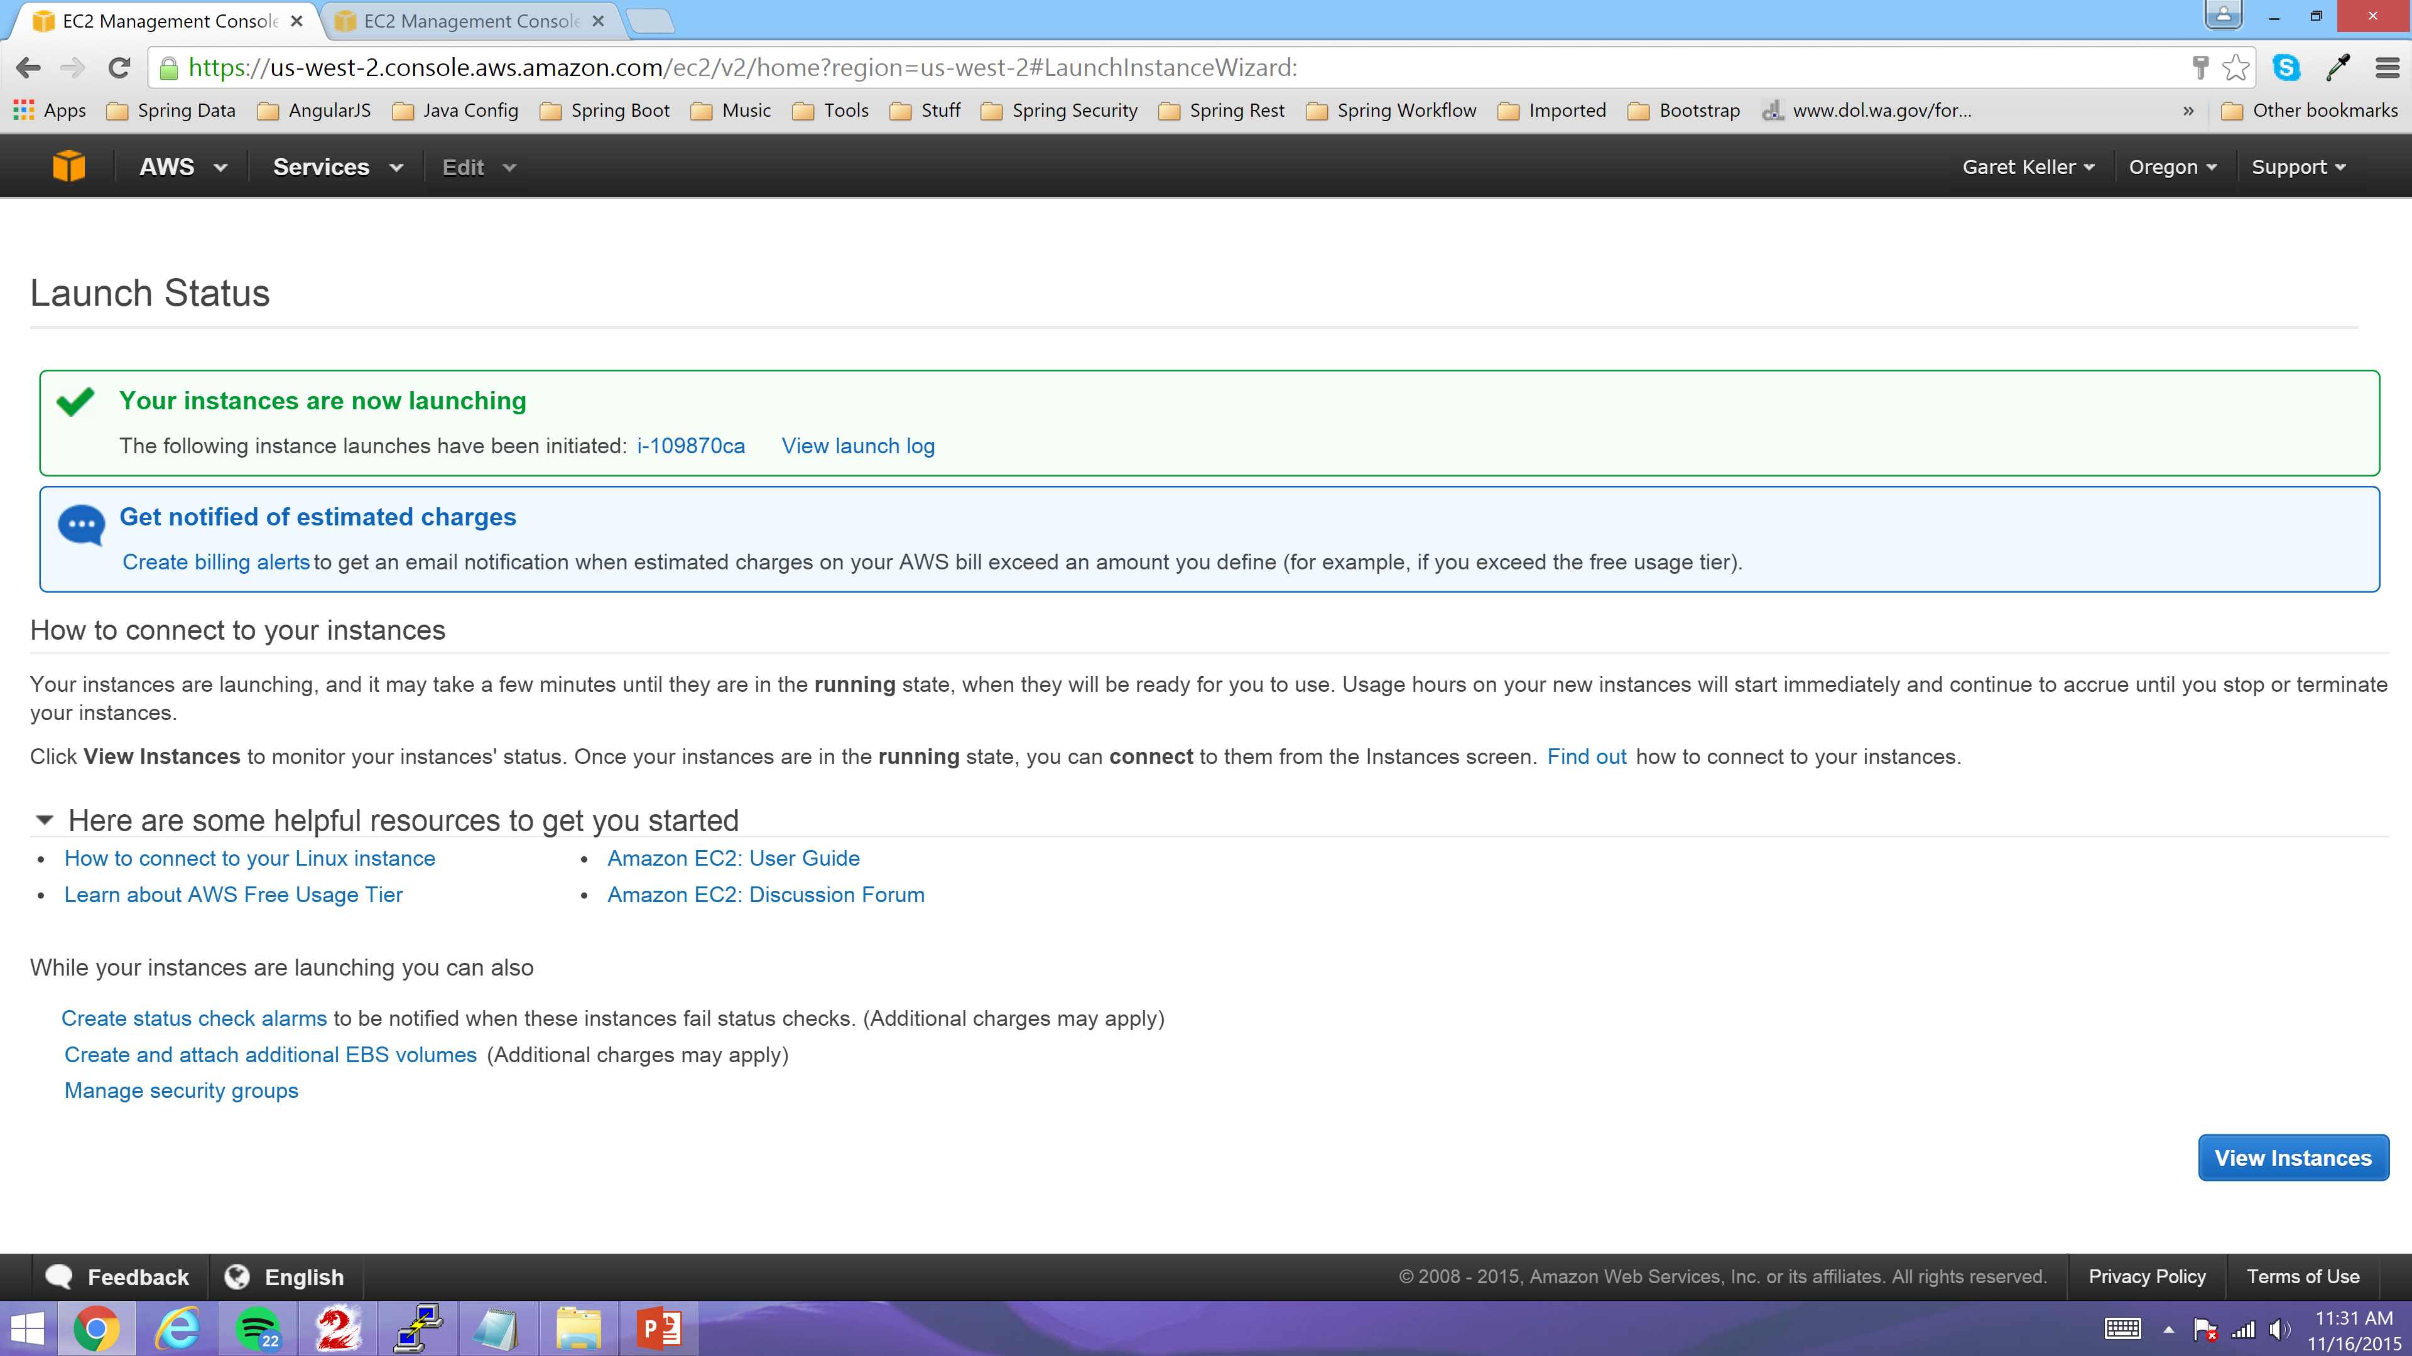
You should now see screen showing the successful Launch of your new Server and click“View Instances”

Slide 16
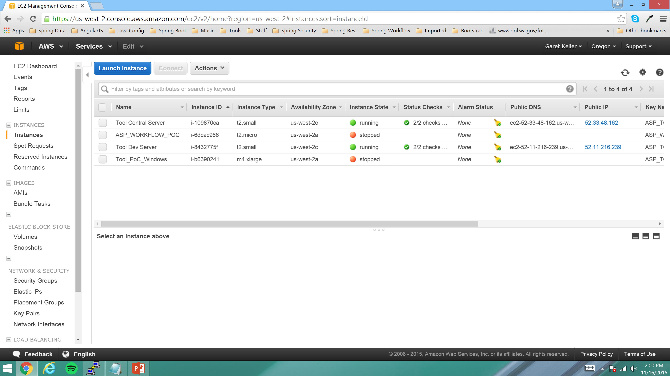
You should now see your new Server up and running

Slide 17
Create an Elastic IP Address
An “Elastic” IP Address is an IP Address that you can reserve indefinitely. Thus allowing you more flexibility and ease of administration. Thus we have reserved two Elastic IP Addresses for the two Development Servers and those IP Addresses will never change and can be reused by ASP for any purpose.

Slide 18

Click the “Elastic IPs” link in the AWS Console as shown below

Slide 19
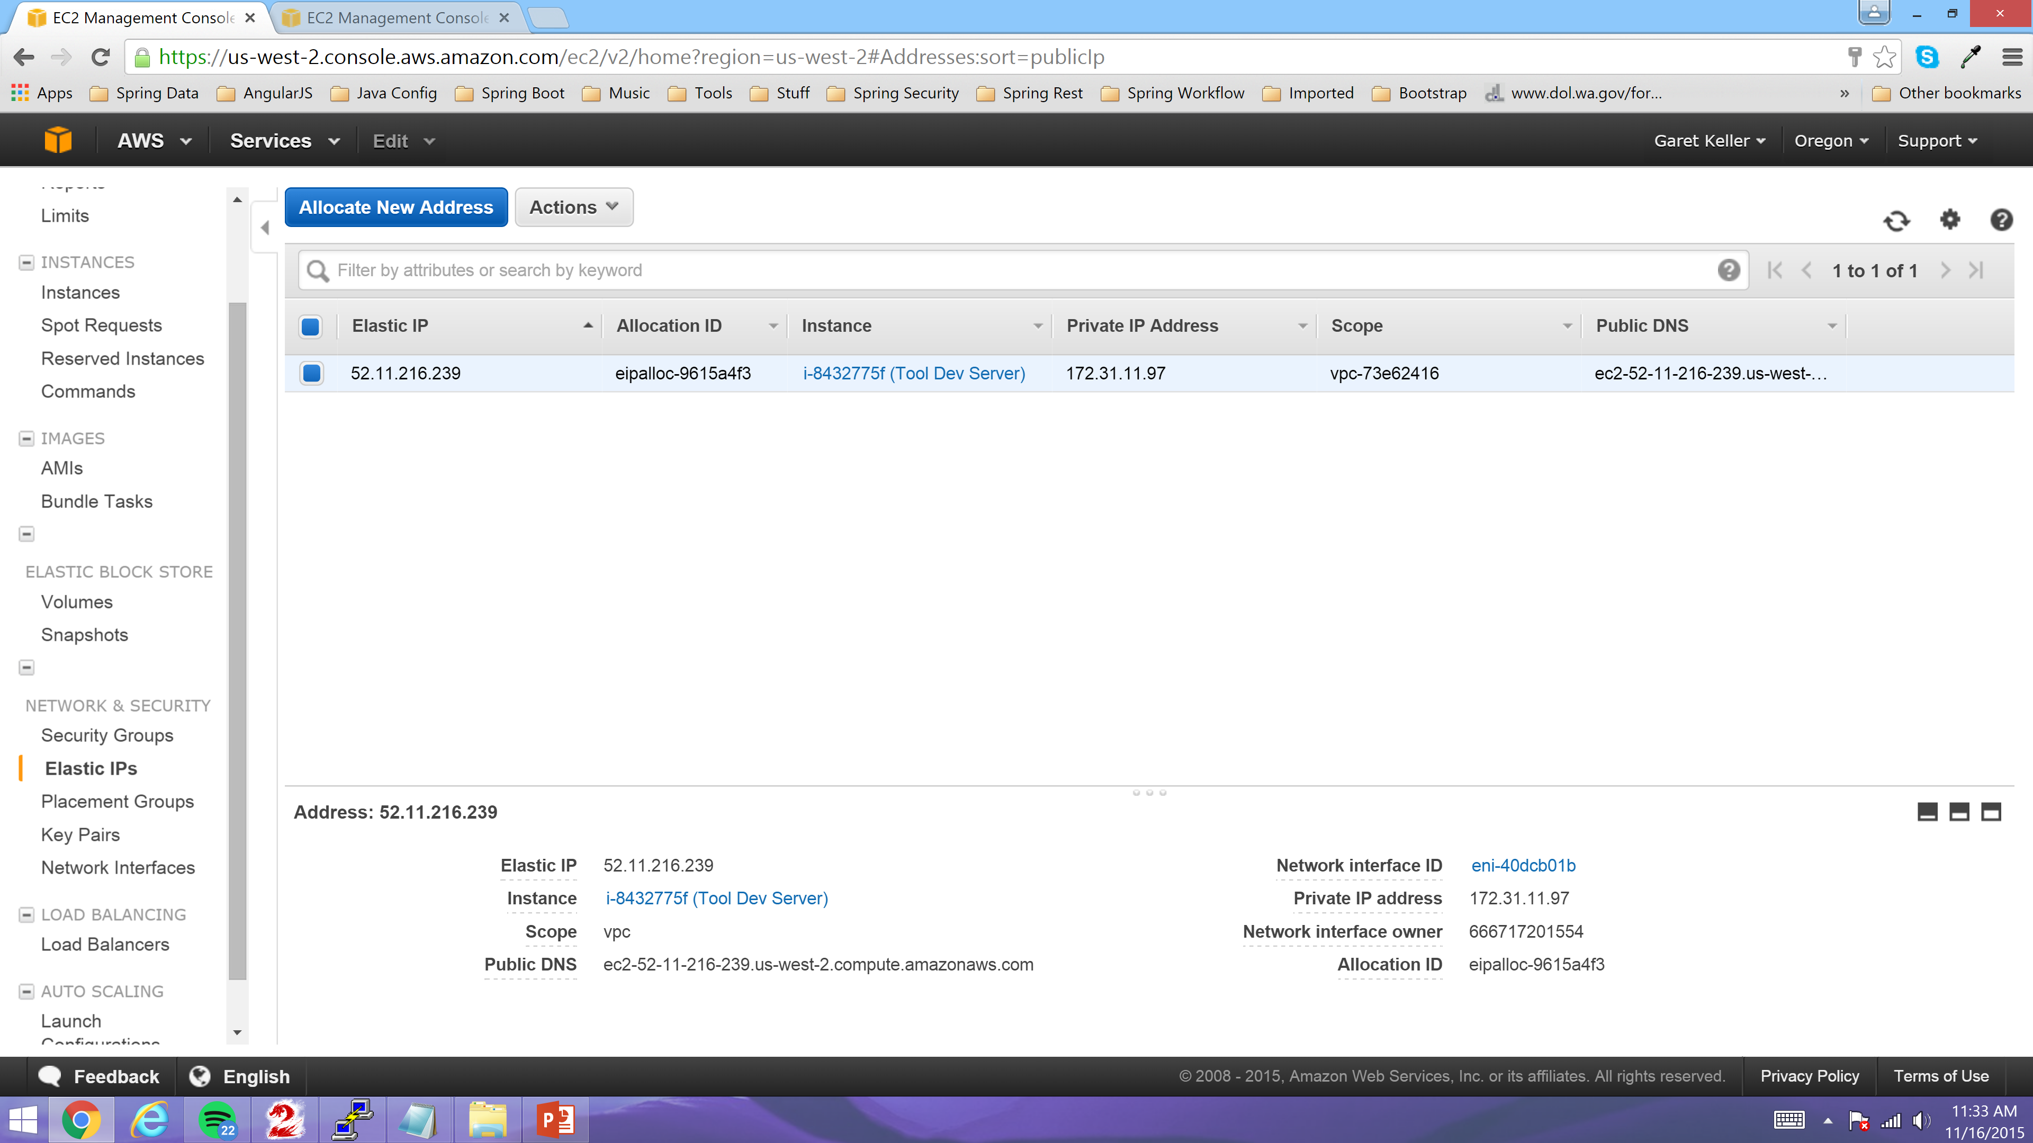
Click the “Allocate New Address” Link

Slide 20
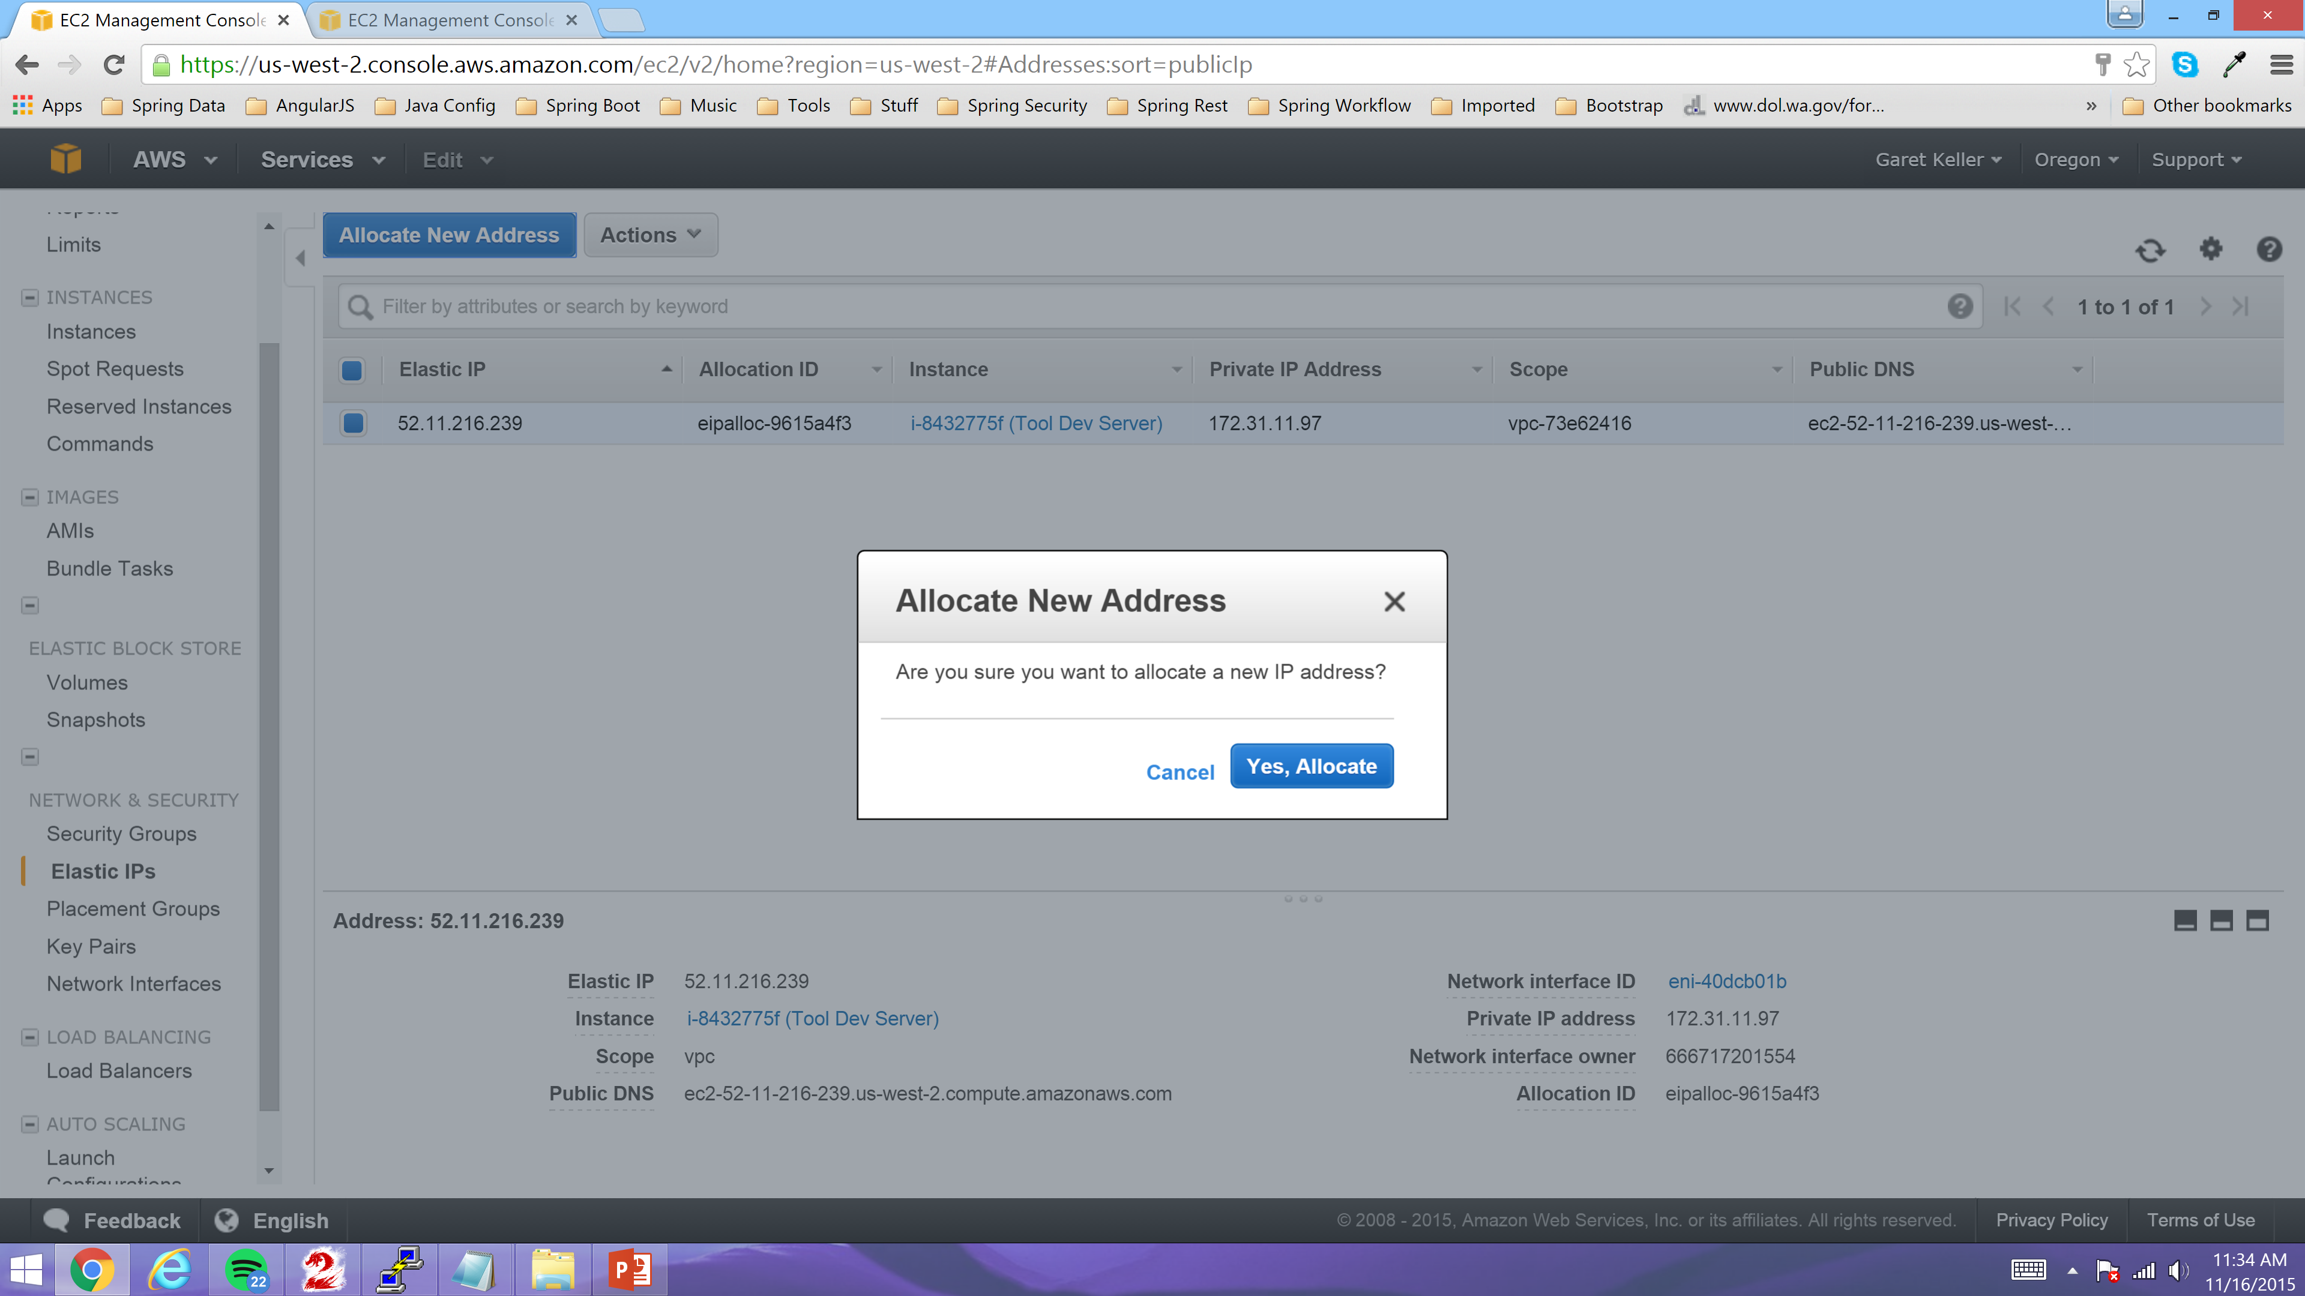
Click the “Yes, Allocate” Link

Slide 21
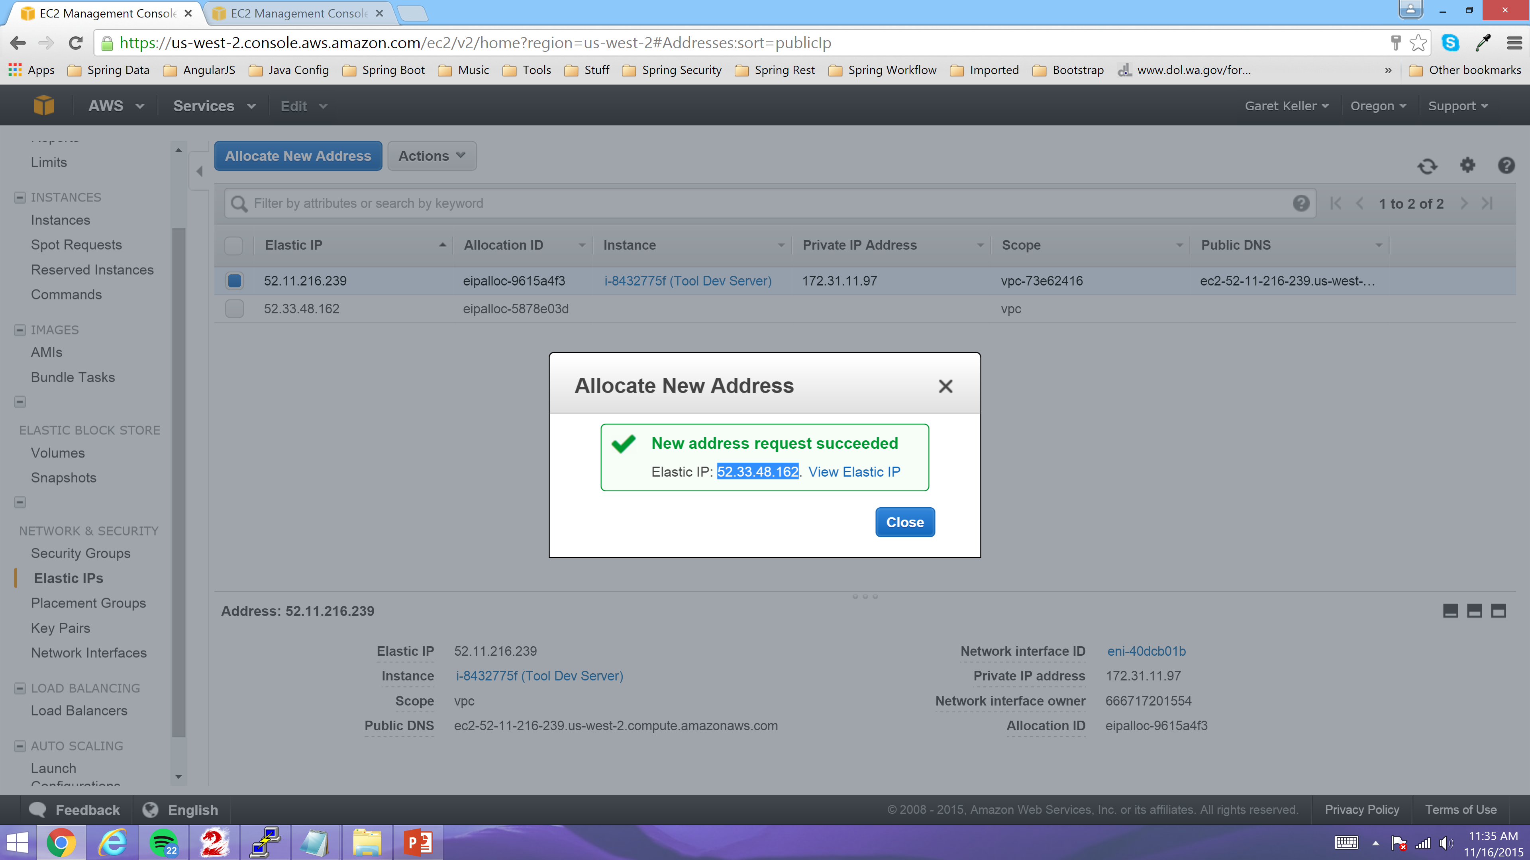
Click the “Close” Link

Slide 22
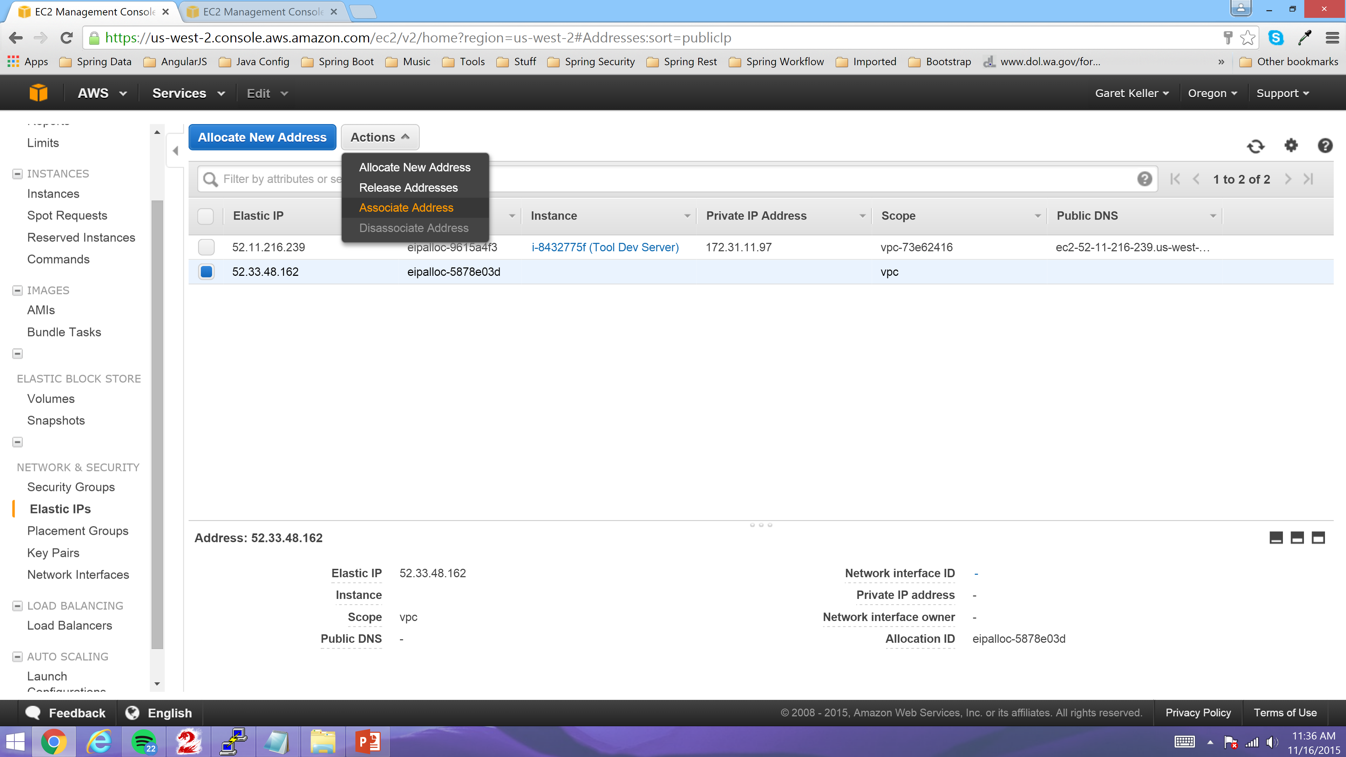
Click the “Associate Address” Link

Slide 23
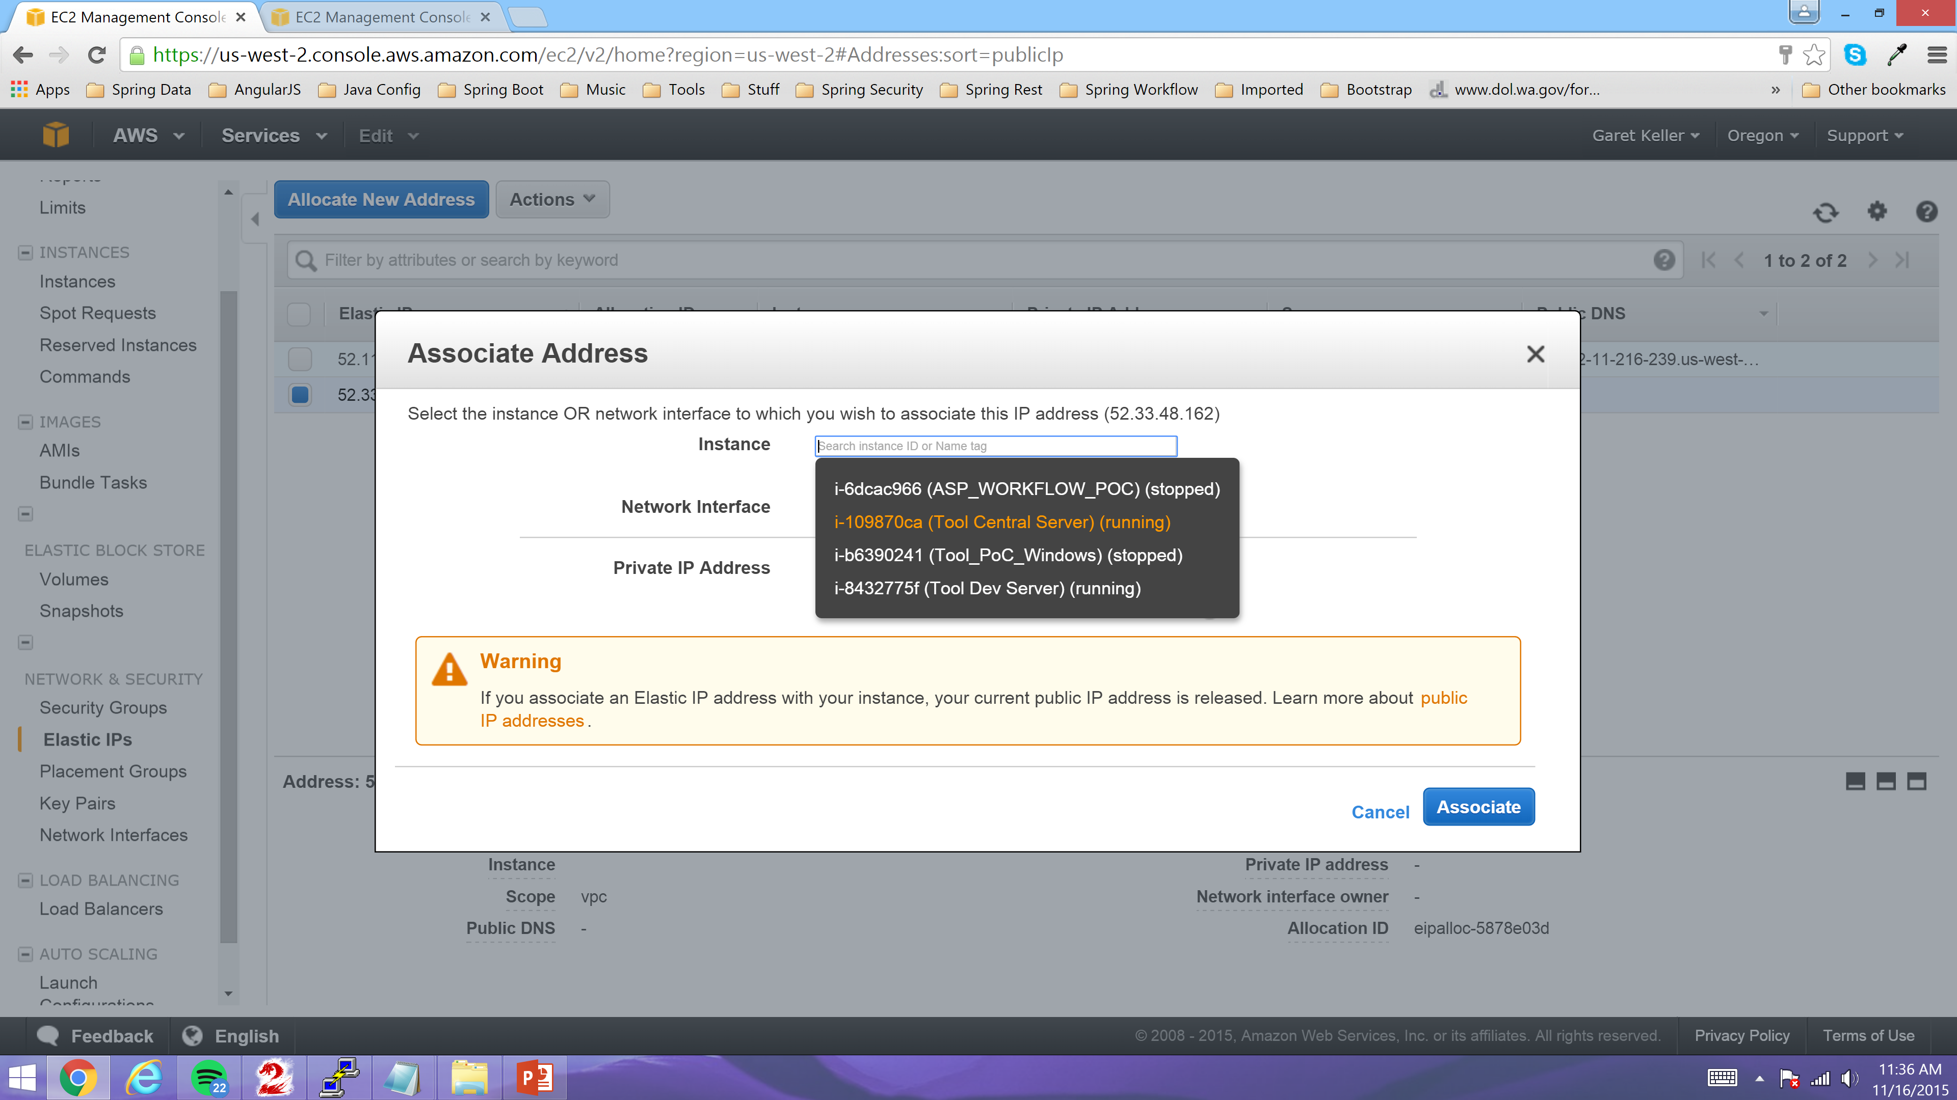
Select the newly created Server from the Instance Drop Down as shown below

Slide 24
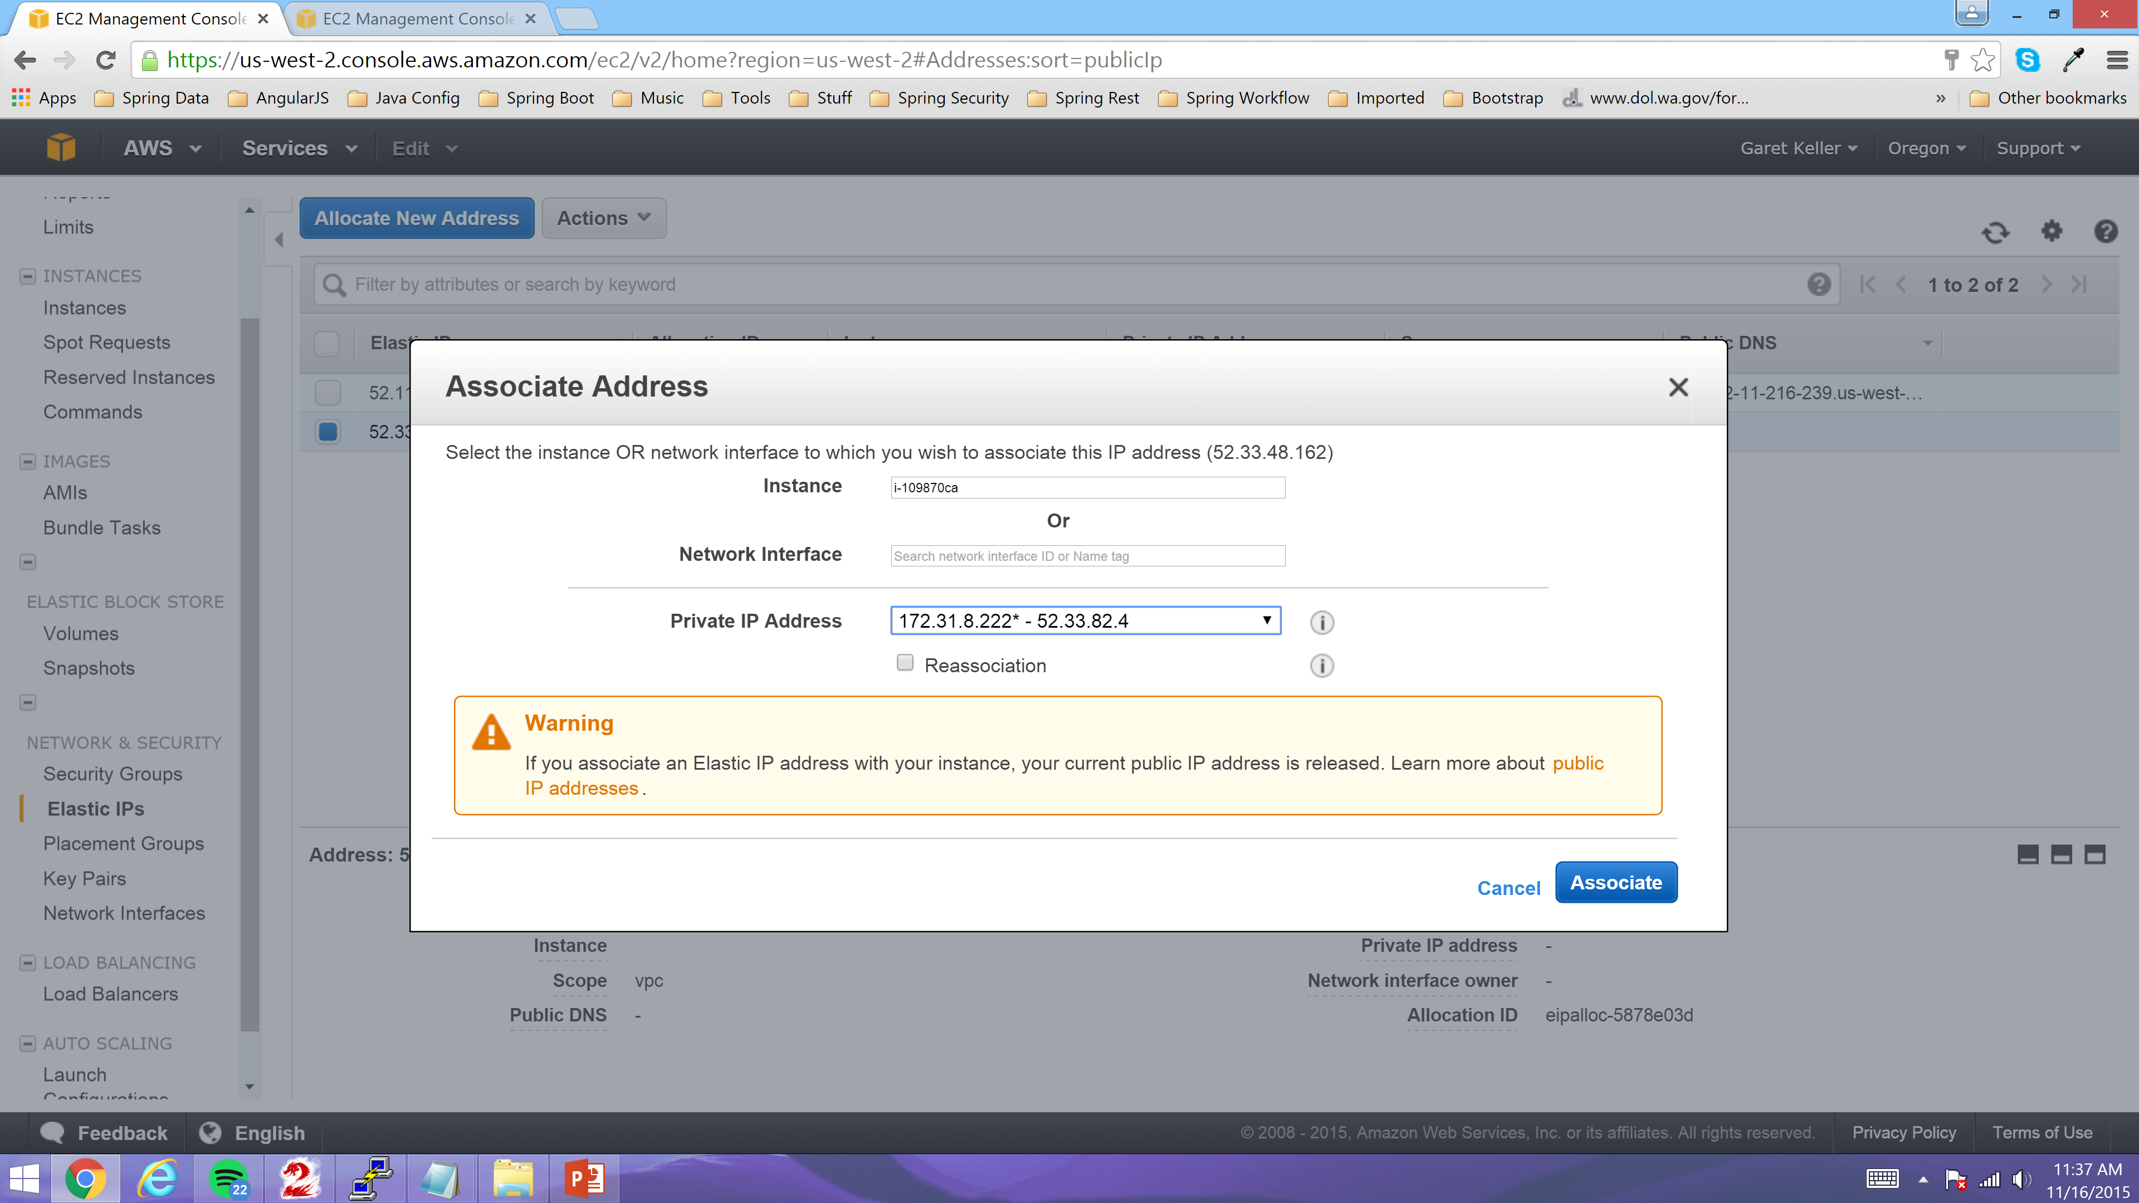
Then click the “Associate” Link

Slide 25
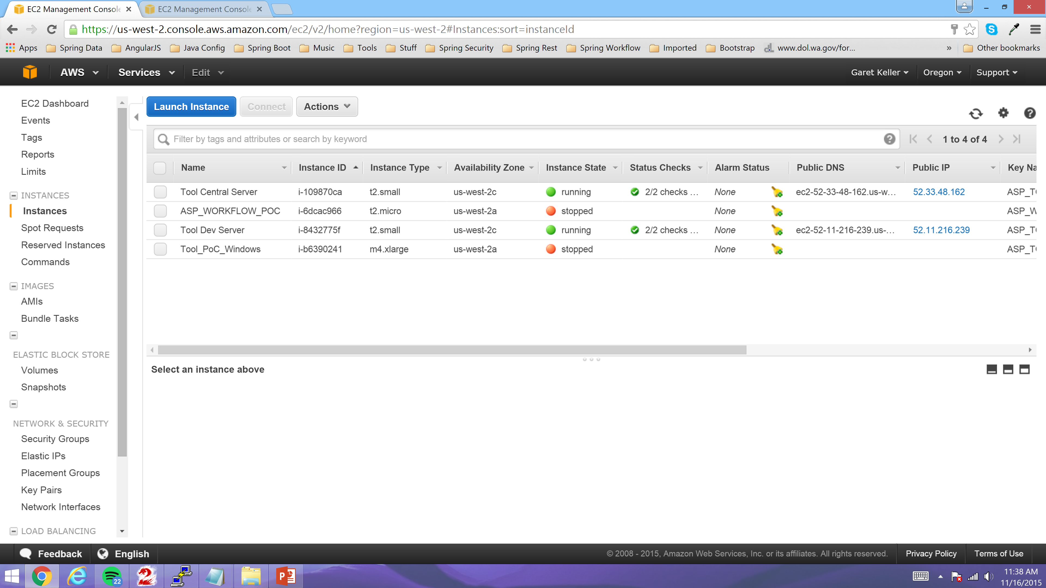
New Server should be up and running with new Public Elastic IP Address

Slide 26
Connect to new AWS Server via Putty/SSH and configure Server.

Slide 27
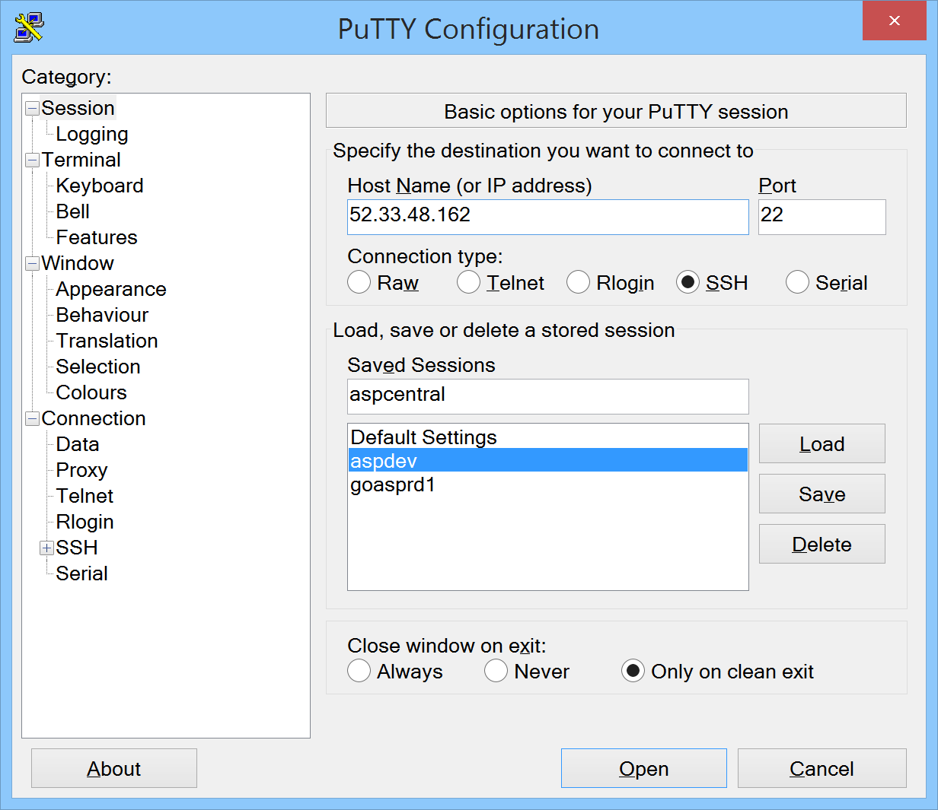
Open a Putty Session and add the new Server. Then click “Window” on the left Menu.

Slide 28
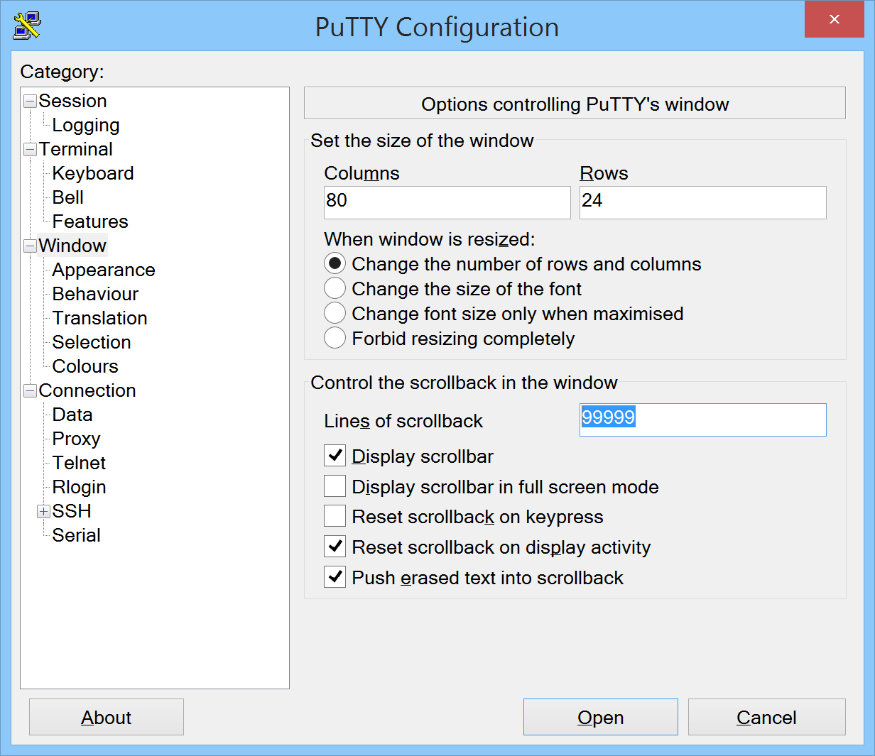
Enter 9999 into the “Lines of scrollback” text box. Then click “Data” under “Connection” on the left Menu.

Slide 29
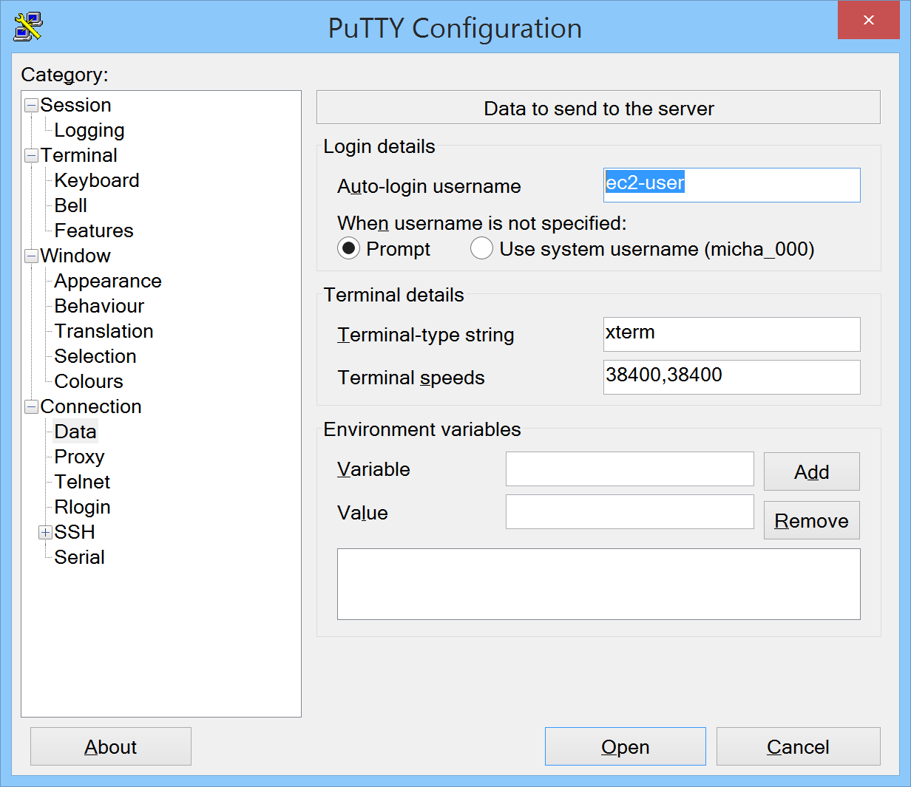
Enter ec2-user in the “Auto-login username” text box then click the “SSH” like expand it and then click “Auth“ under “SSH”

Slide 30
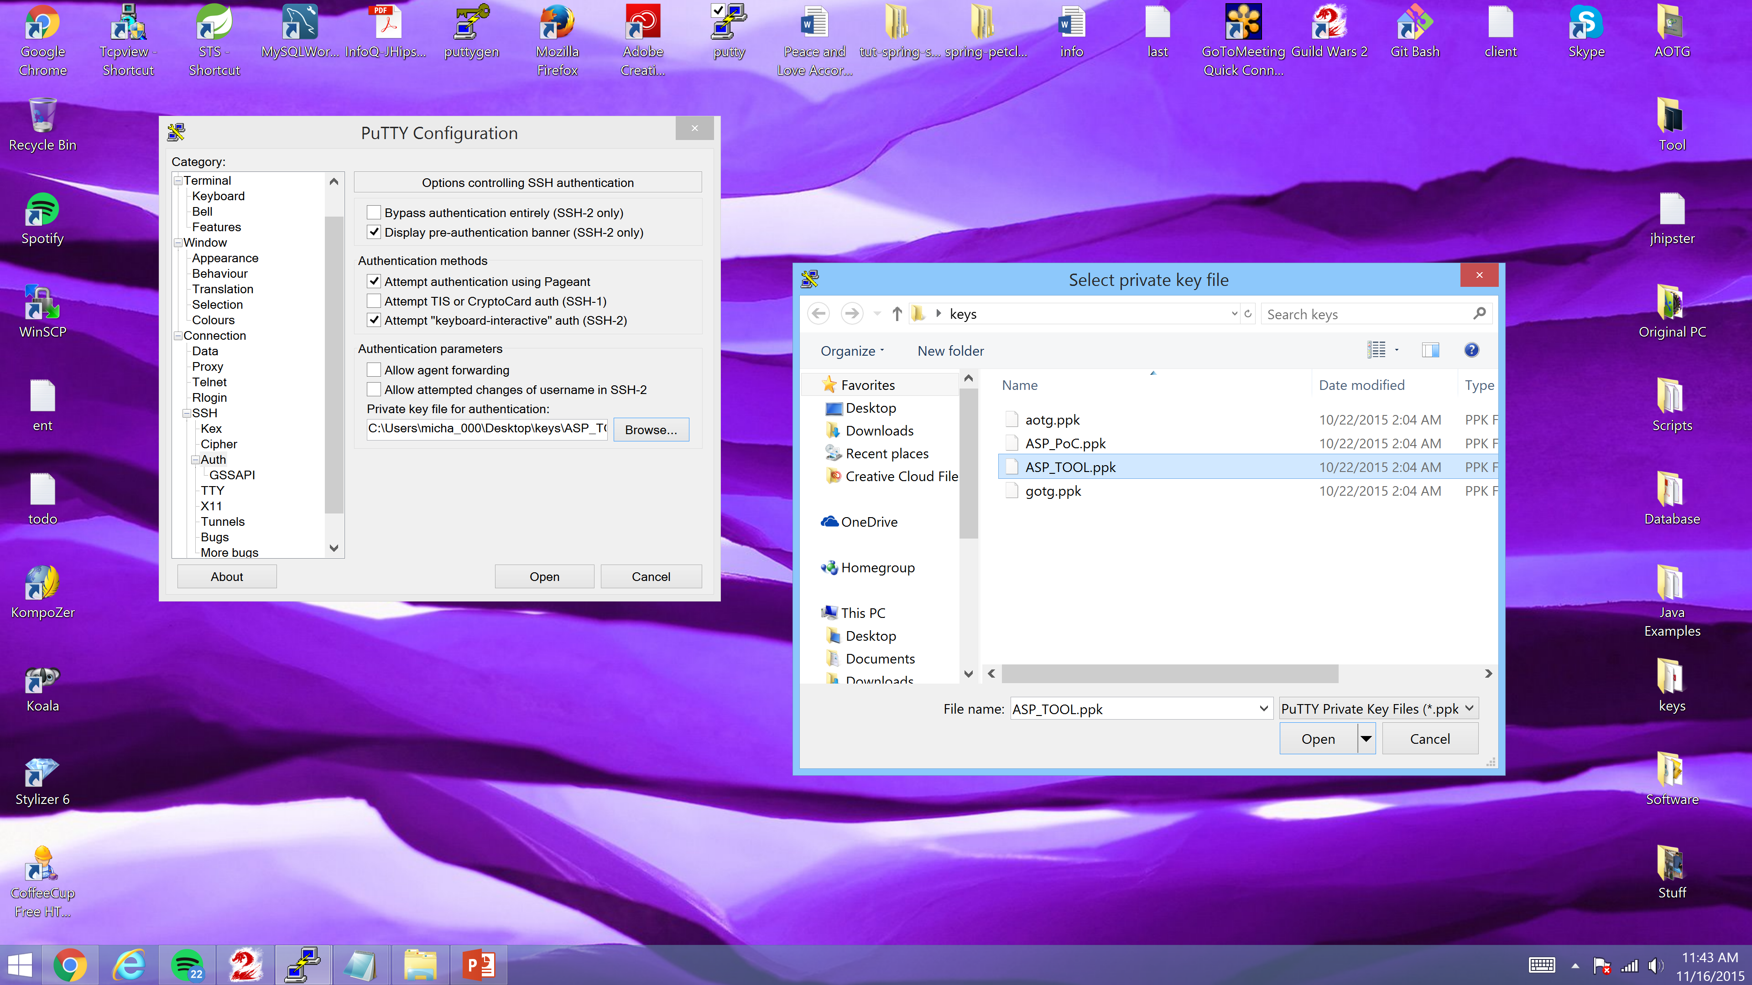
Click the “Browse” button under the “Private key file for authentication:” Title. Then when the dialog opens navigate to the ASP_TOOL.ppk file that you have downloaded from the Server someplace on your local PC as shown below. Then click the “Open” button to select that private key file. Then click “Session” on Putty’s left hand “Category:” menu

Slide 31
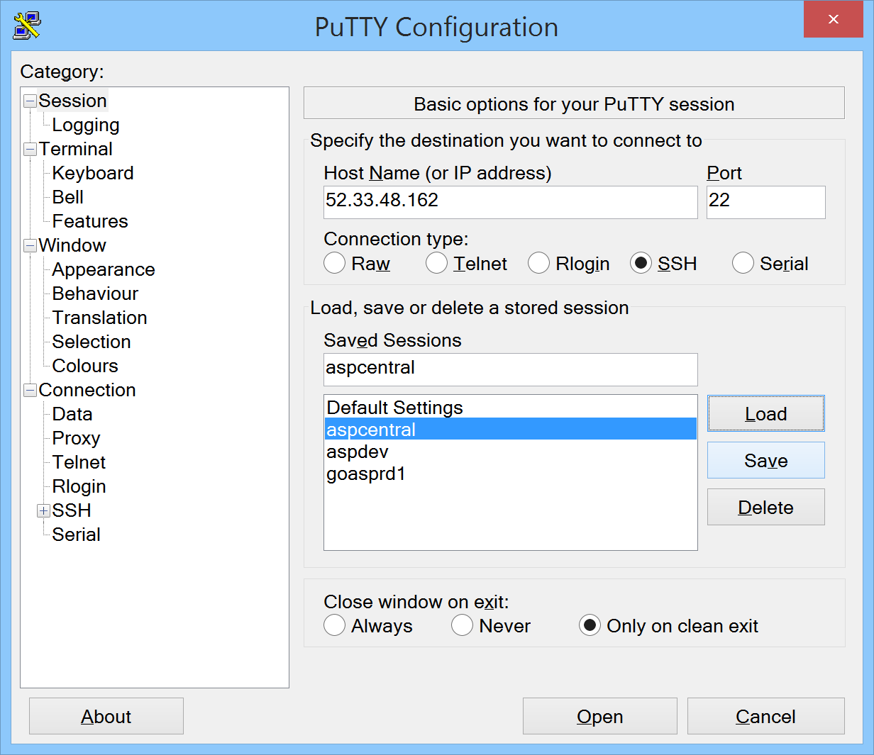
Click the “Save” button to save all of the settings we have just entered for this new Server config.

Slide 32
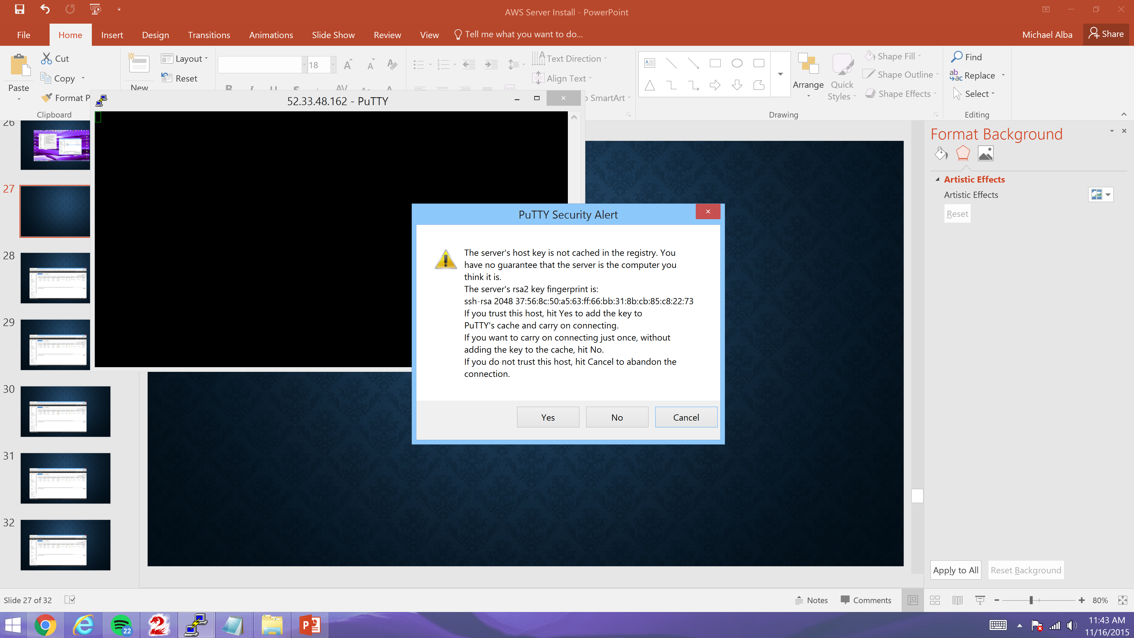
Login to your newly created Putty Server Session. Click “Yes” to accept cache.

Slide 33
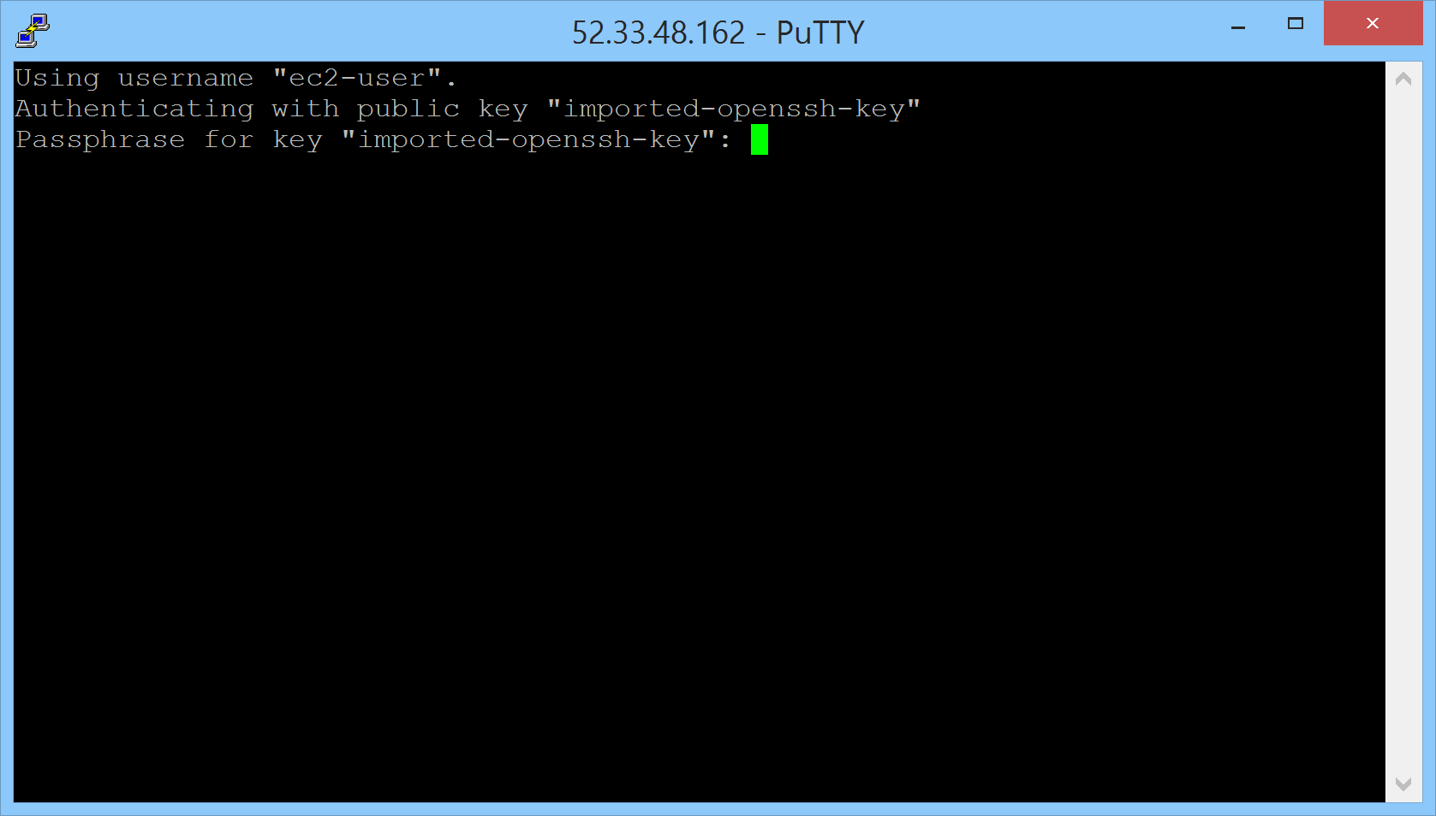
Enter the ecs-user password which is also stored in the key when prompted and hit enter

Slide 34
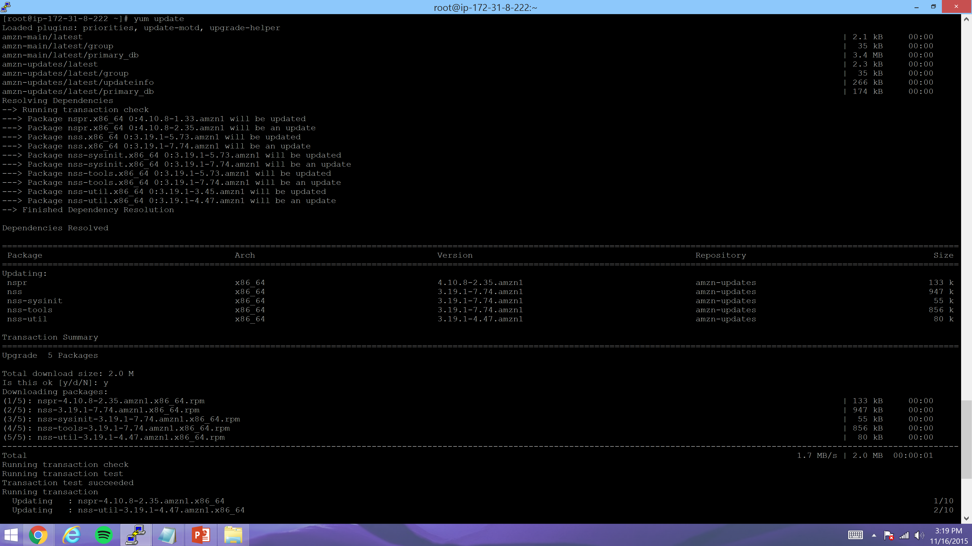
Run the “Sudo su –” command to login as root and then run “yum update” as shown below

Slide 35
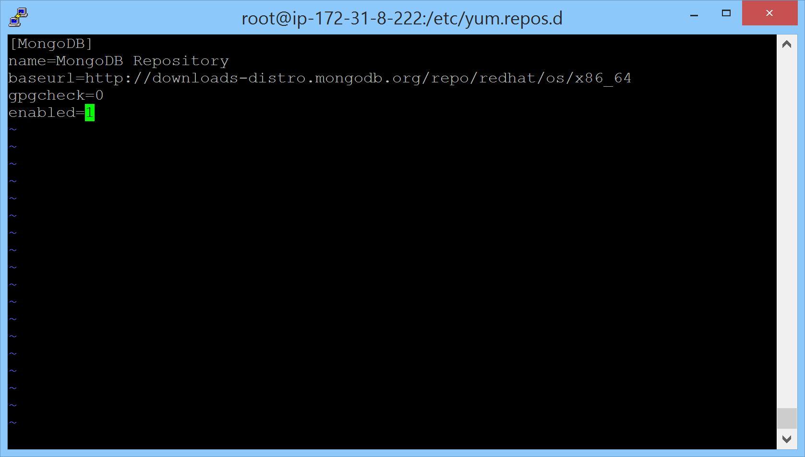
Navigate to the /etc/yum.repos.d directory and create a new file as shown below. Save it as “mongodb.repo”

Slide 36
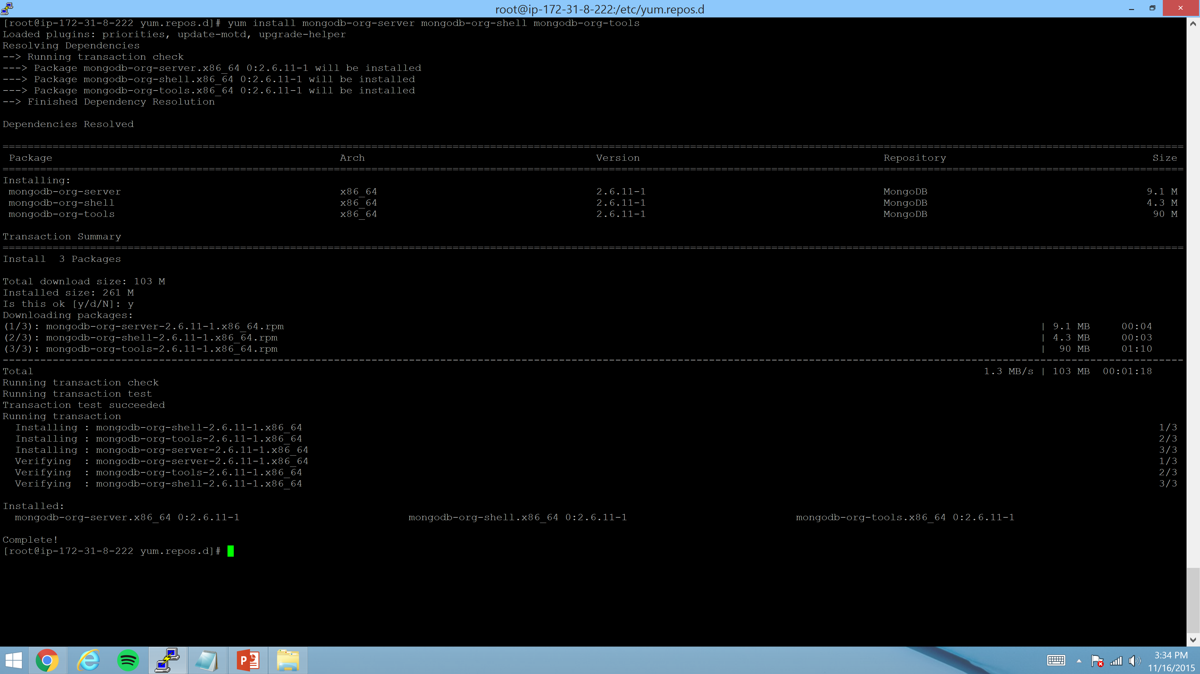
Run the “yum install mongodb-org-server mongodb-org-shell mongodb-org-tools” command as shown below to install mongodb.

Slide 37
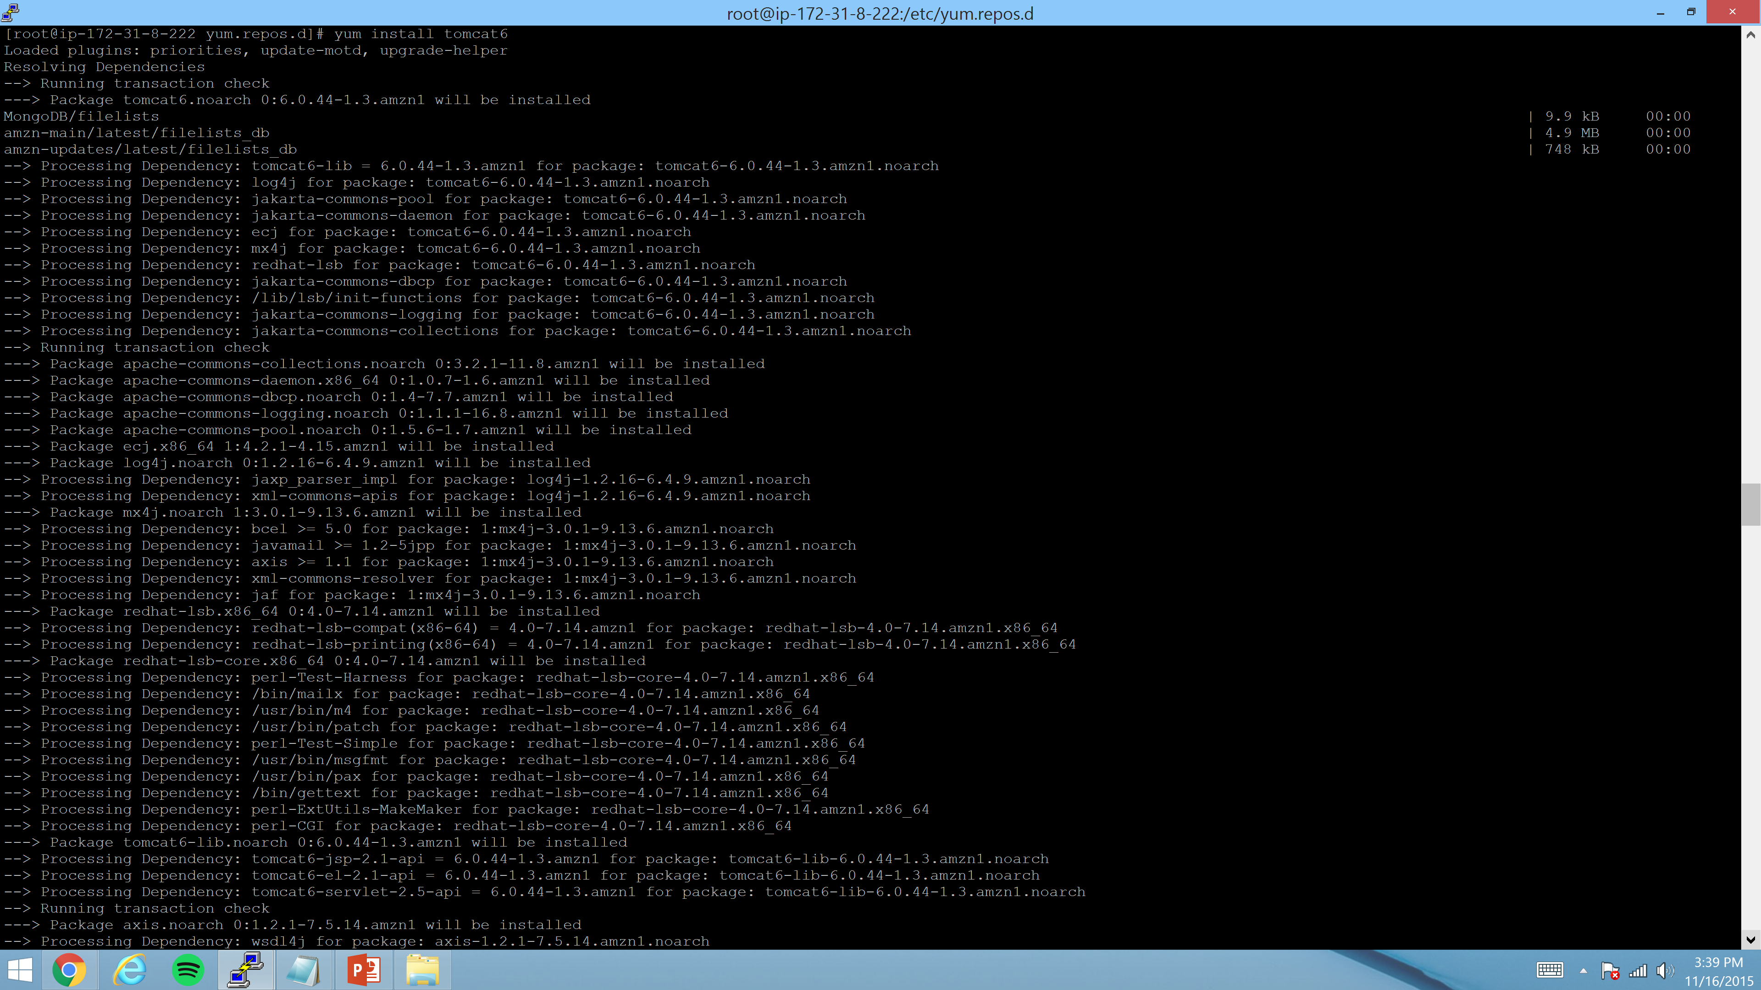
Run the “yum install tomcat6” command as shown below to install tomcat6.

Slide 38
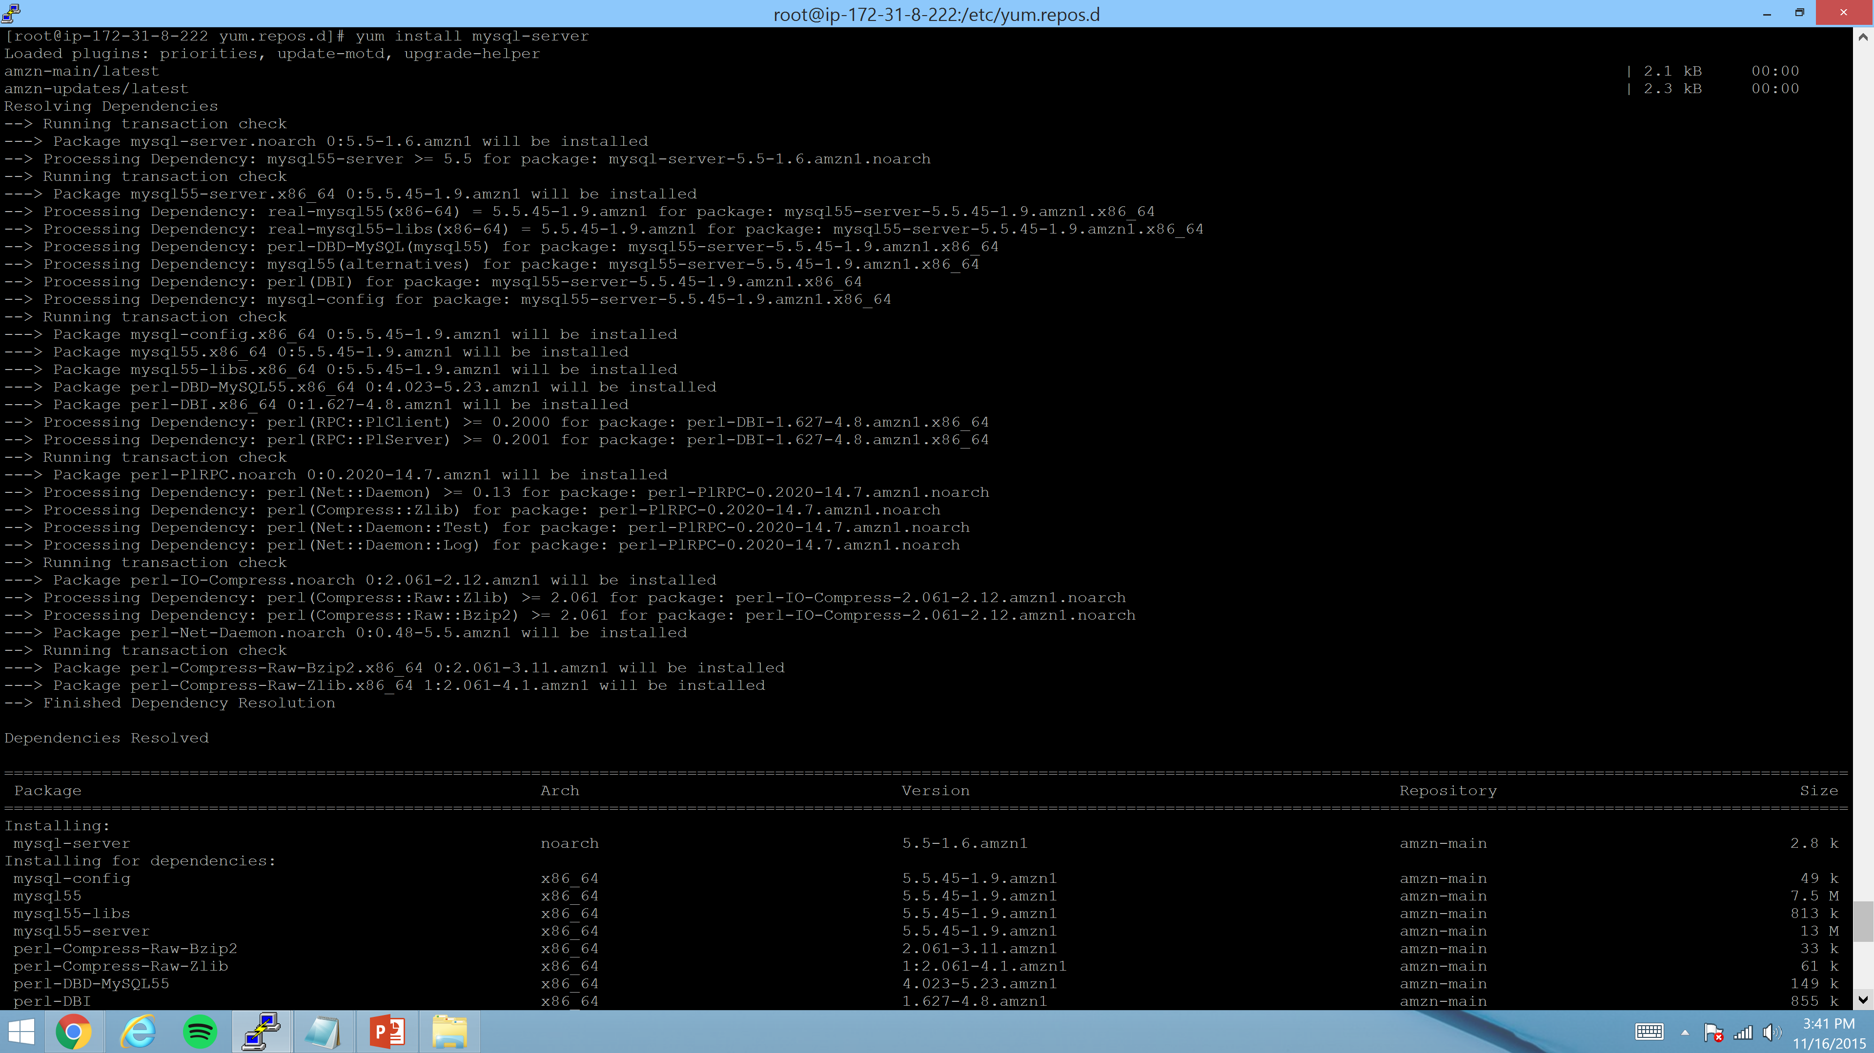
Run the “yum install mysql-server” command as shown below to install mysql.

Slide 39
Run the “yum install tomcat6” command as shown below to install tomcat6.

Slide 40
Perform MongoDB configurations.

Slide 41
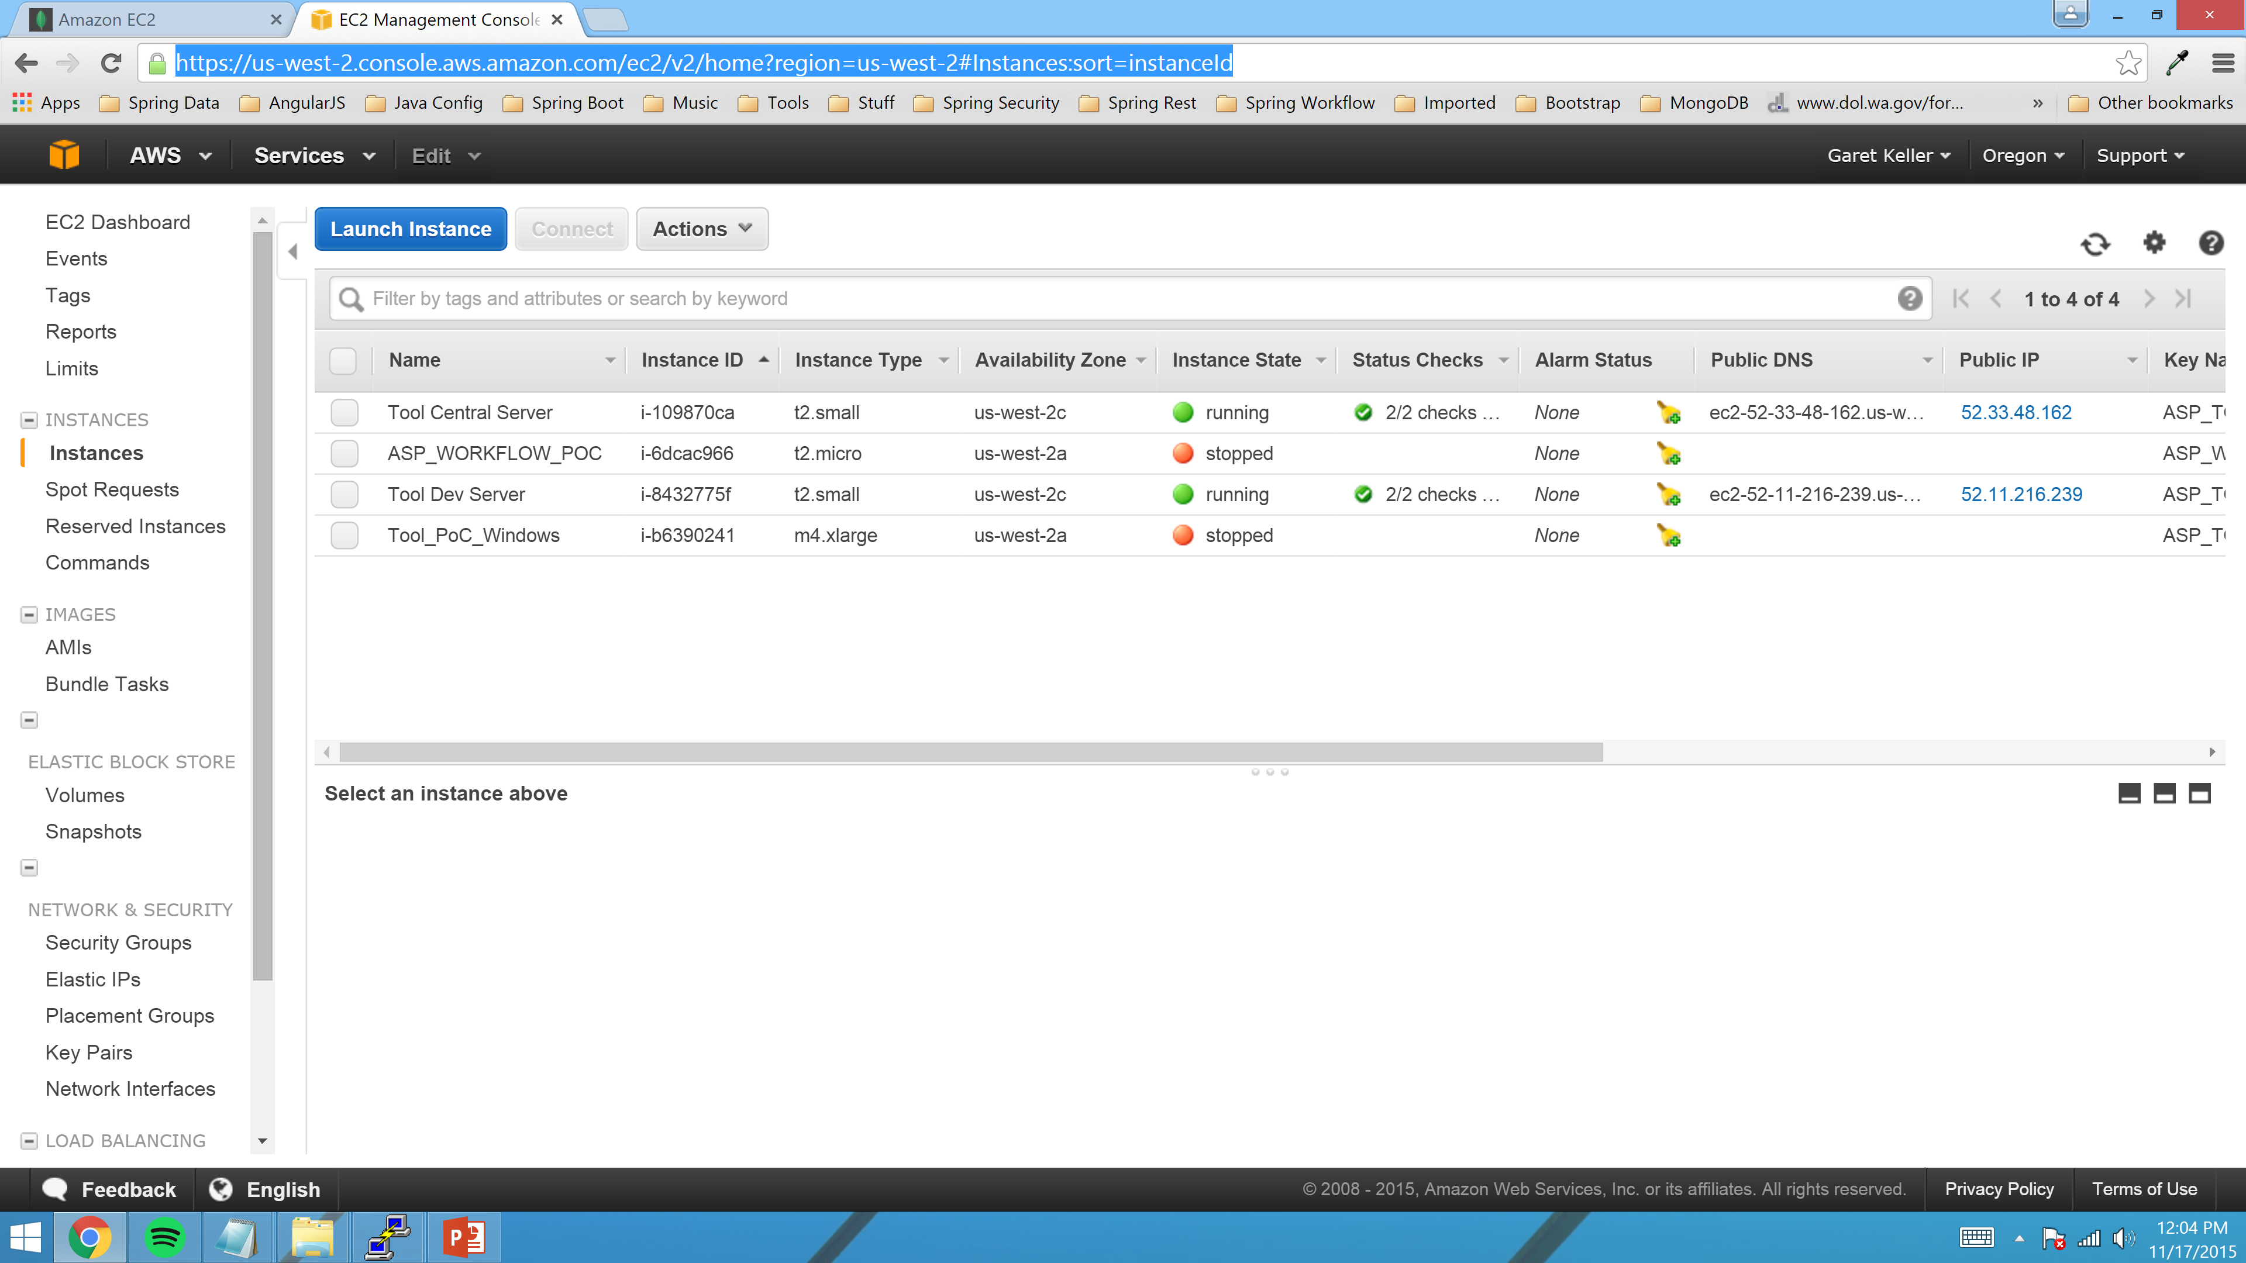
Navigate to the “Volumes” Page

Slide 42
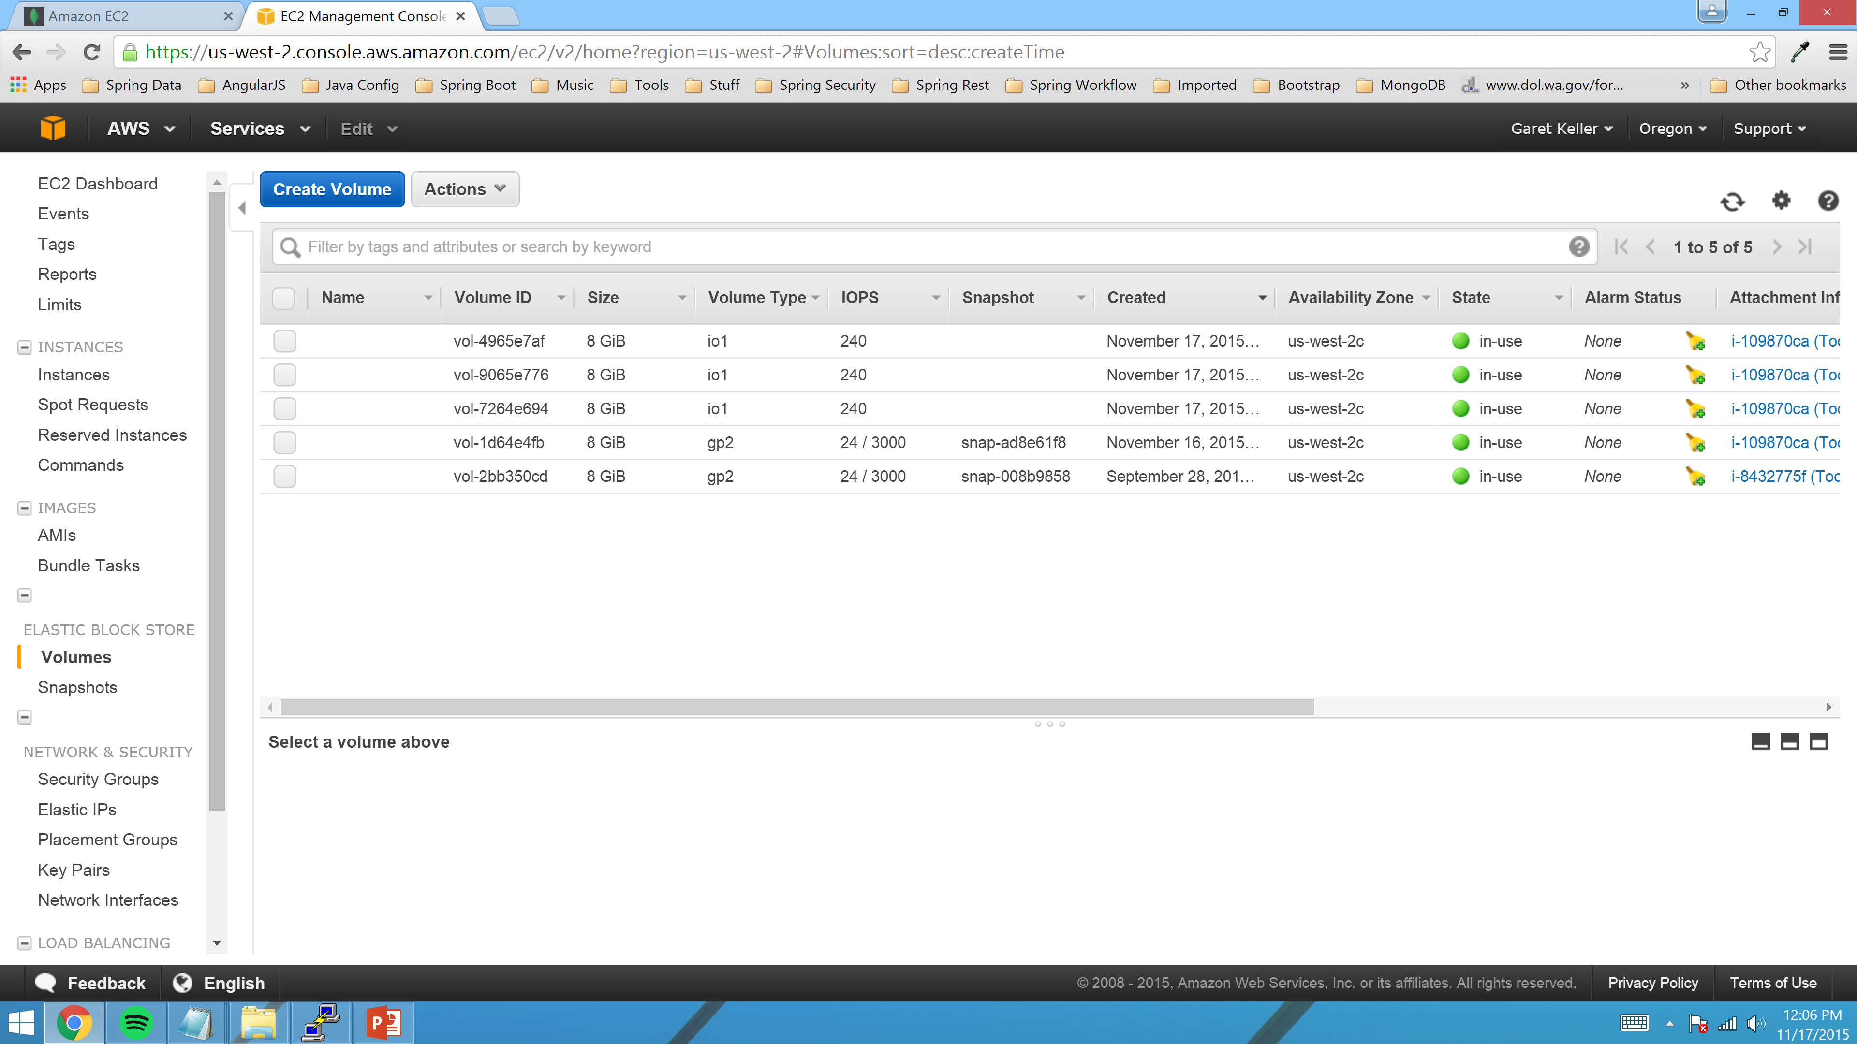
Click the “Create Volume” button

Slide 43
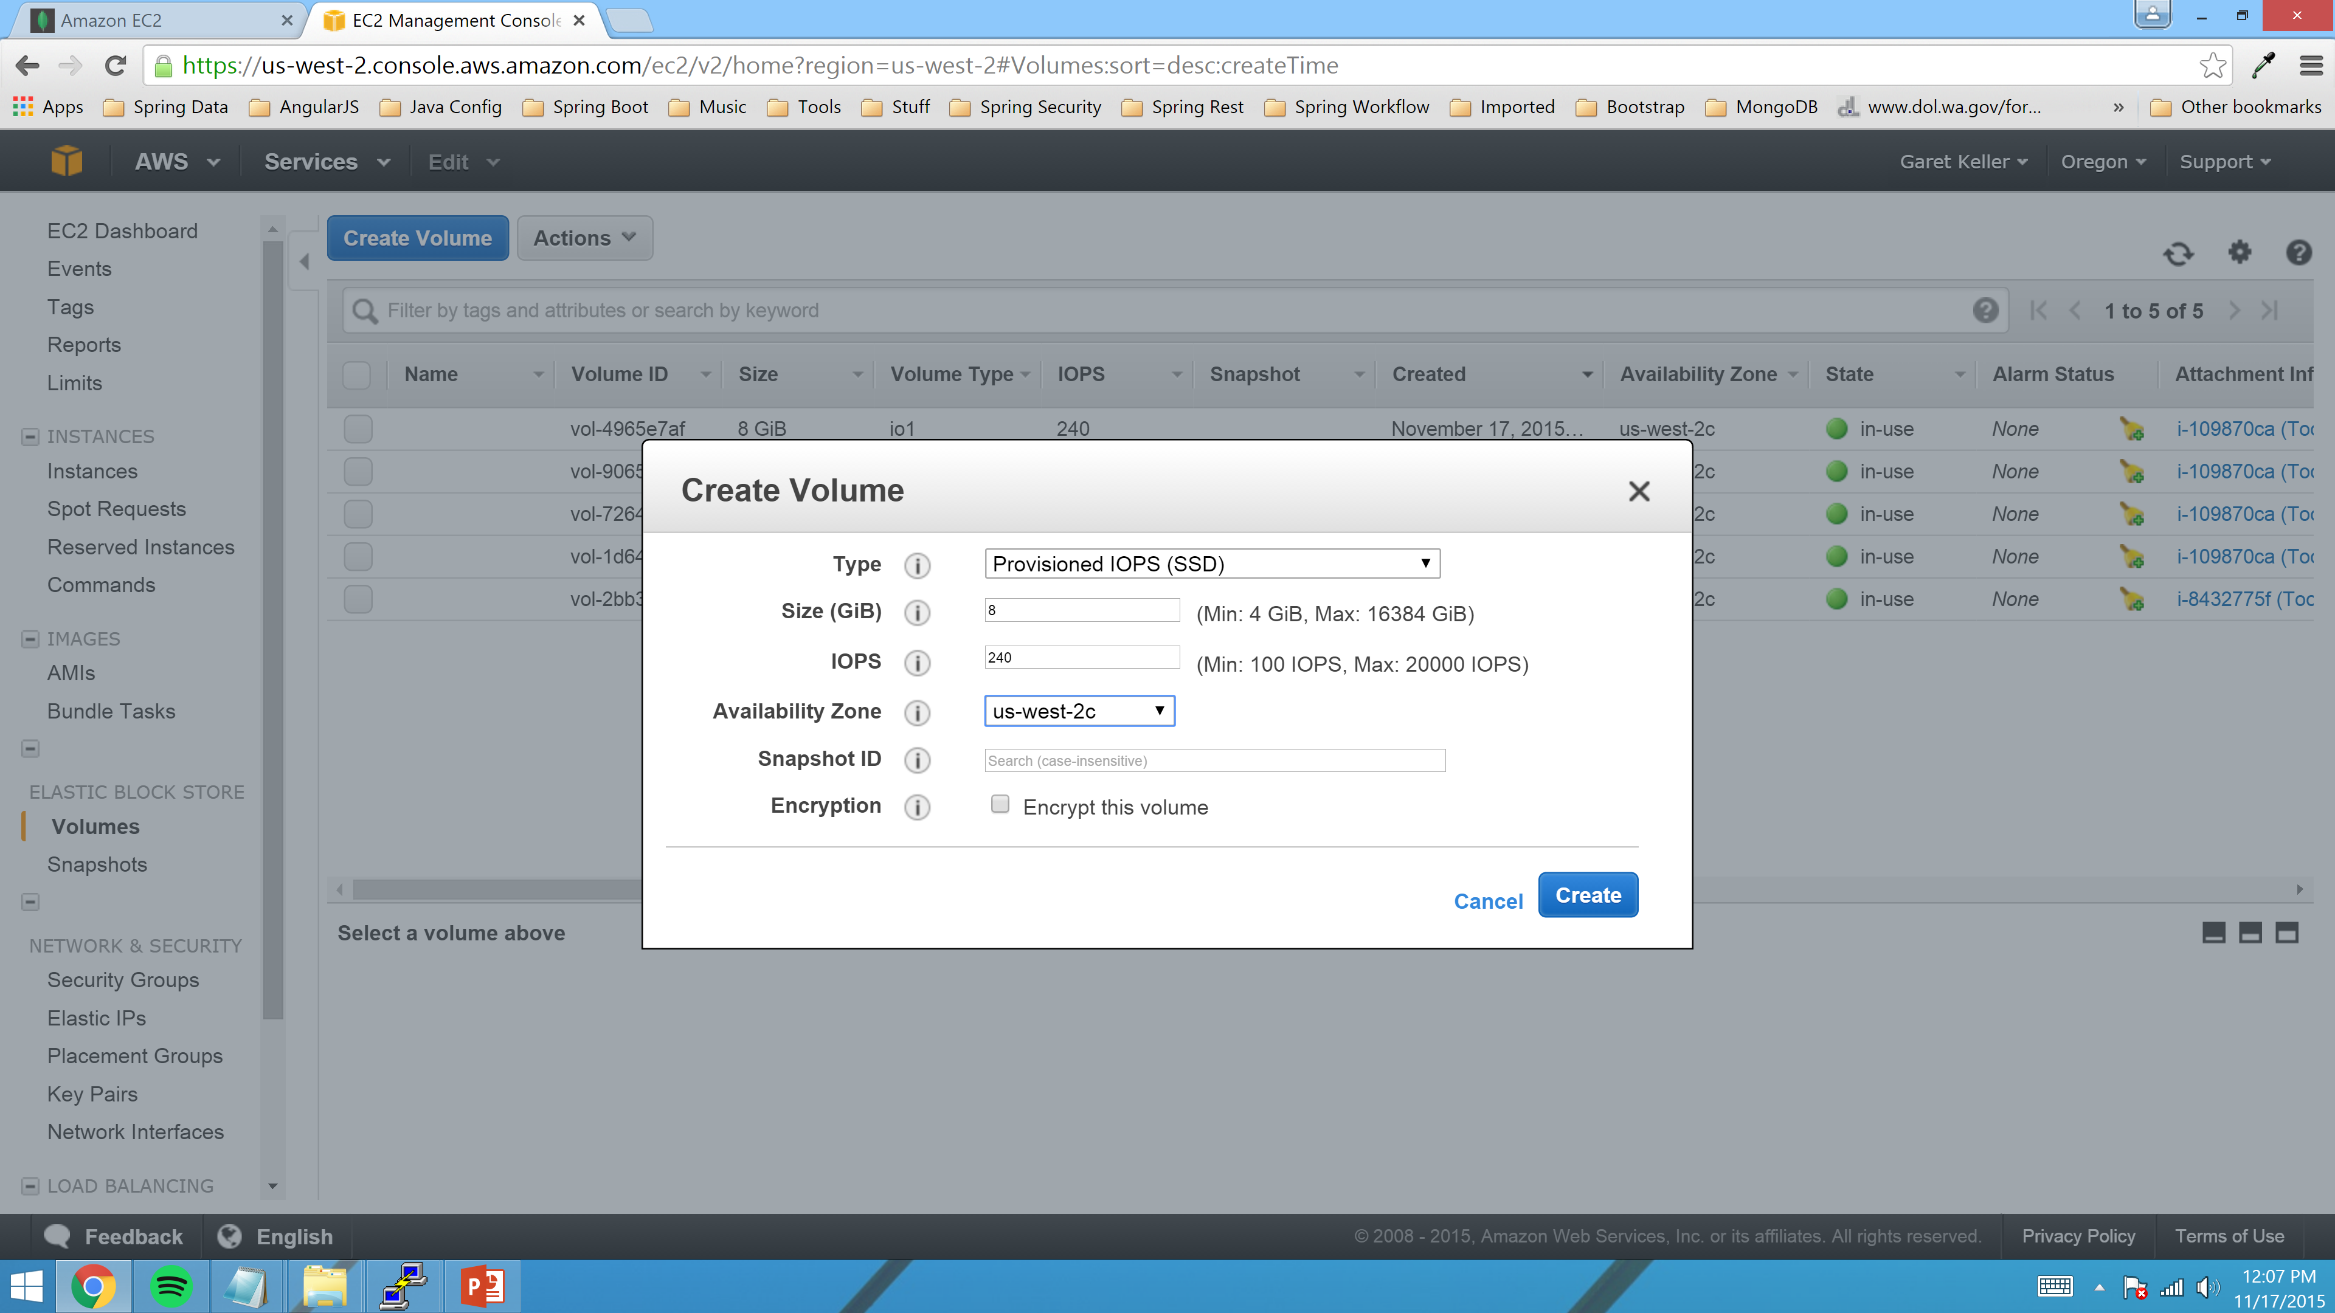
Enter the following values and click “Create”

Slide 44
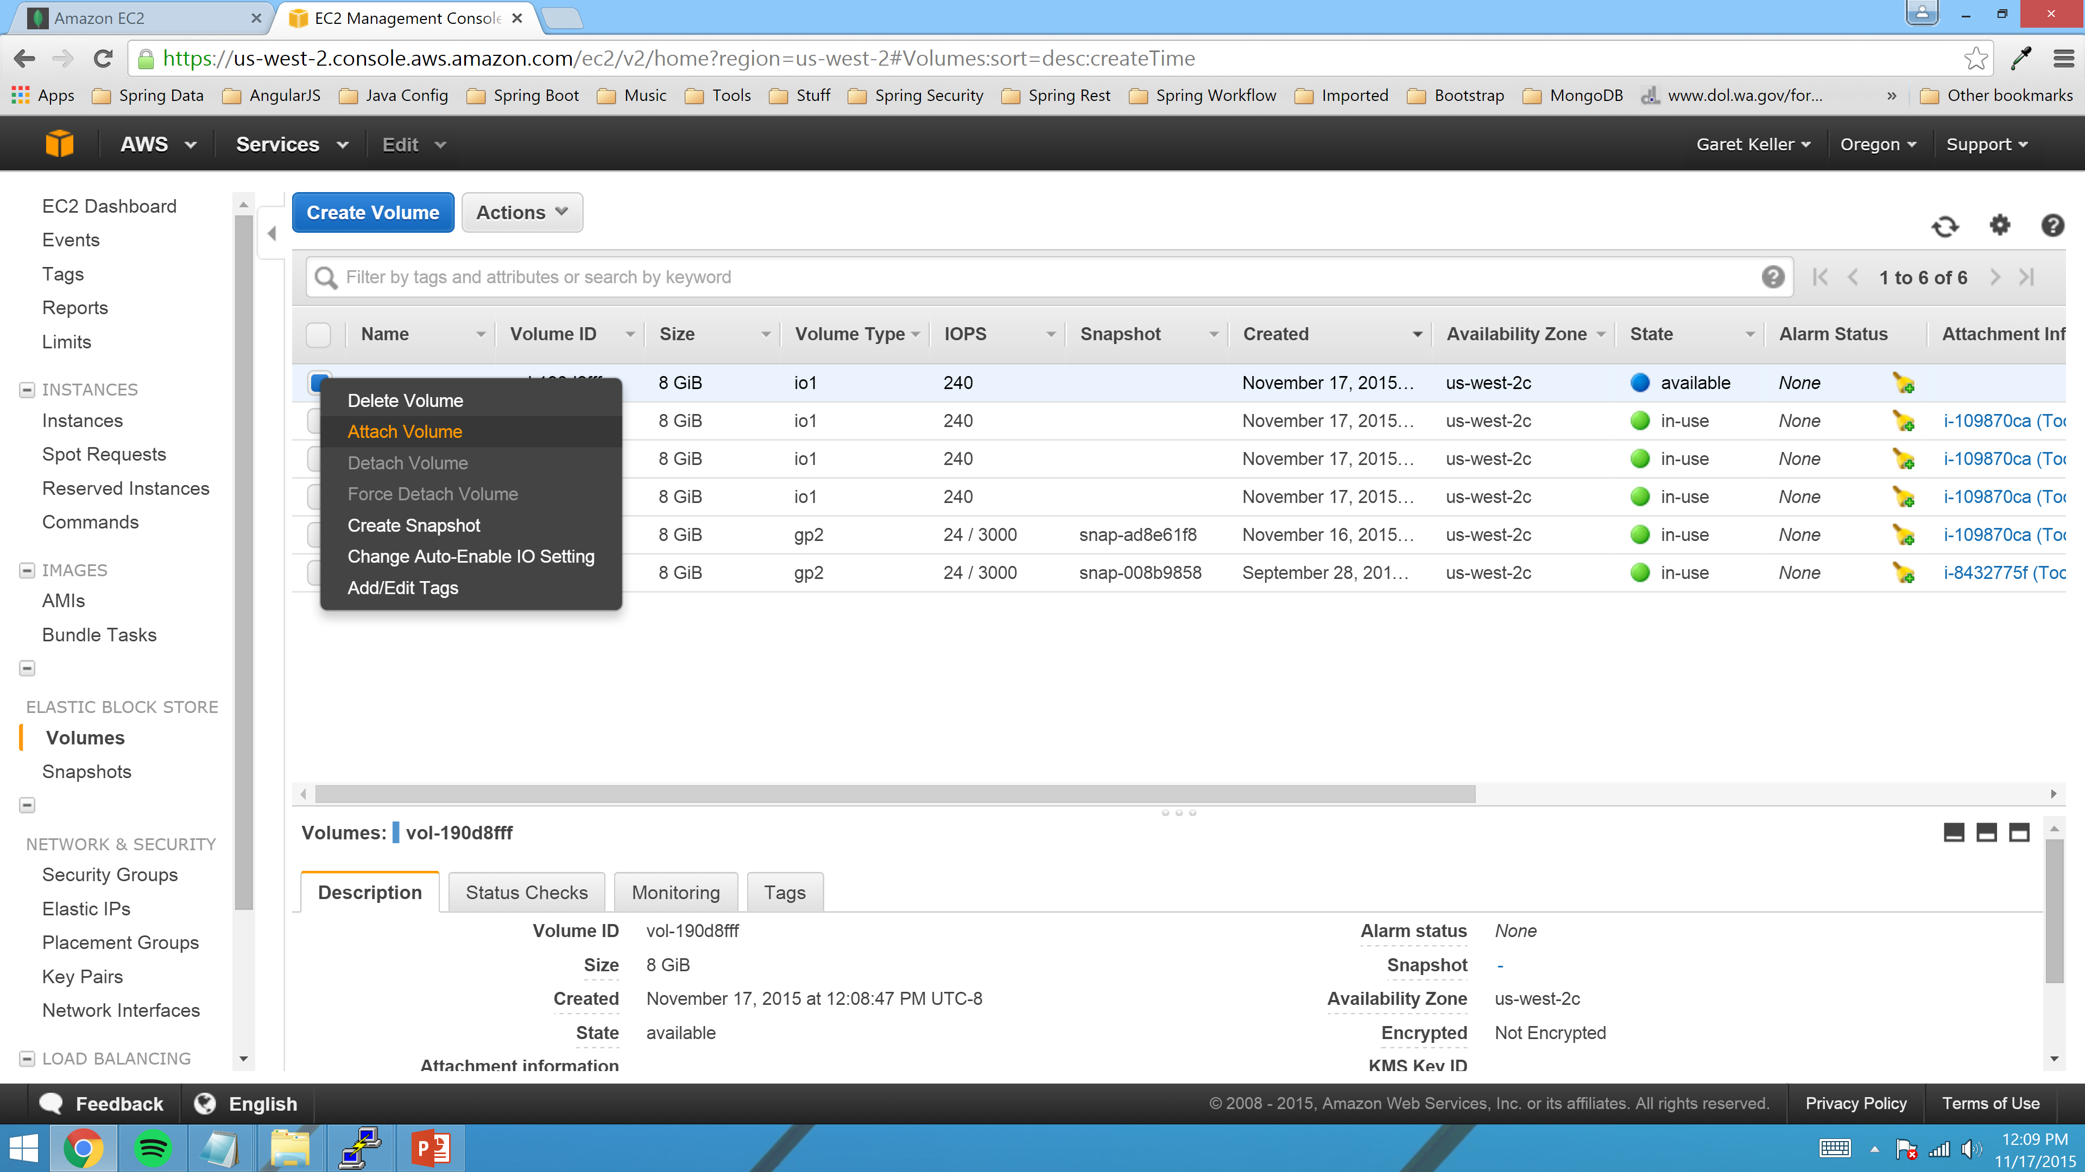
Select the newly created, unassigned Volume and right click and select “Attach Volume”

Slide 45
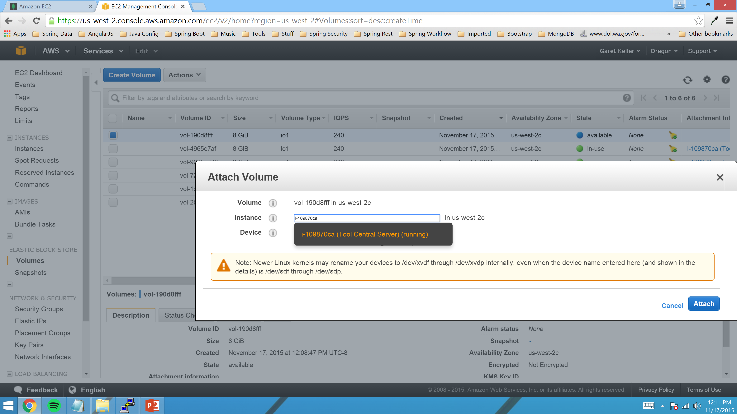
Select the instance you want to assign the Volume to. Then select the Device or Mount name and click “Attach”. Do this two more times as we need three Volumes.

Slide 46
Run the following Unix commands as the “root” user on the MongoDB server.
mkdir /data /log /journal
mkfs.ext4 /dev/xvdf
mkfs.ext4 /dev/xvdg
mkfs.ext4 /dev/xvdh
Add the following to the /etc/fstab file:
/dev/xvdf /data ext4 defaults,auto,noatime,noexec 0 0
/dev/xvdg /journal ext4 defaults,auto,noatime,noexec 0 0
/dev/xvdh /log ext4 defaults,auto,noatime,noexec 0 0
mount /data
mount /journal
mount /log
chown mongod:mongod /data /journal /log
ln -s /journal /data/journal
Modify /etc/mongod.conf and set the following parameter values to the following:
dbpath=/data
logpath=/log/mongod.log
Modify /etc/security/limits.conf and add the following values
* soft nofile 64000
* hard nofile 64000
* soft nproc 32000
* hard nproc 32000
echo 'ACTION=="add", KERNEL=="xvdf", ATTR{bdi/read_ahead_kb}="16"' | sudo tee -a /etc/udev/rules.d/85-ebs.rules
echo 'ACTION=="add", KERNEL=="xvdg", ATTR{bdi/read_ahead_kb}="16"' | sudo tee -a /etc/udev/rules.d/85-ebs.rules
echo 'ACTION=="add", KERNEL=="xvdh", ATTR{bdi/read_ahead_kb}="16"' | sudo tee -a /etc/udev/rules.d/85-ebs.rules

Slide 47
Connect to new AWS Server via Web Browser/PEM File.

Slide 48
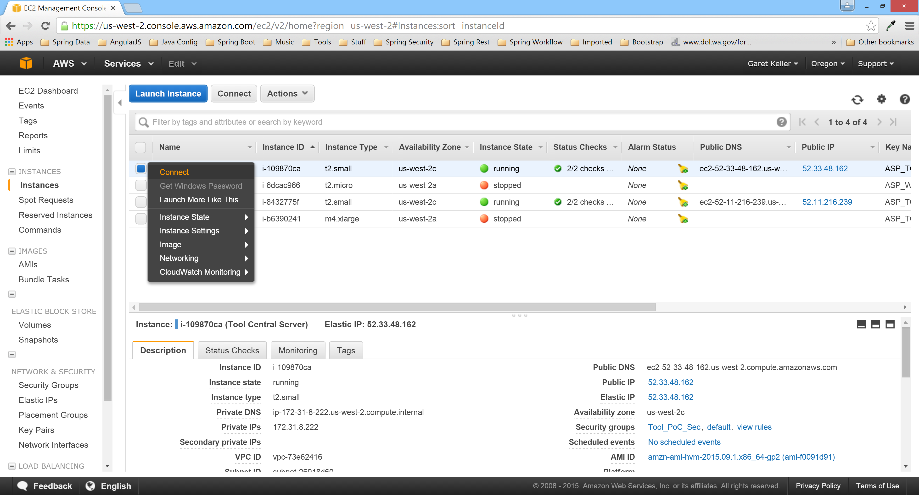
Navigate to the “Instances” Screen and right click on the Server you want to connect to and click “Connect”.

Slide 49
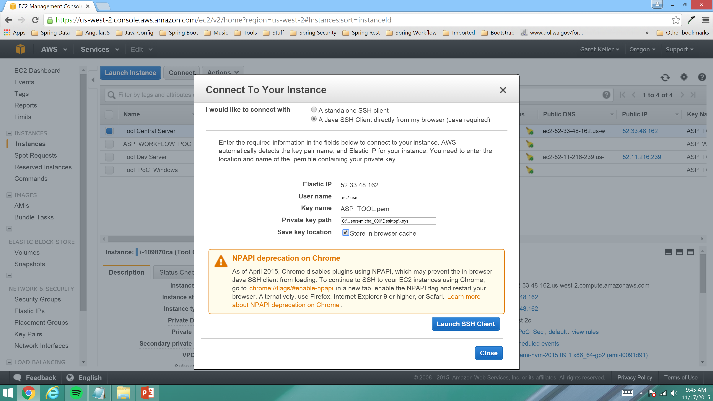
Click on I would like to connect with “A Java SSH Client directly from my browser(Java required)”. Then enter User name as “ec2-user” and enter the path to the ASP_TOOL.pem file and click the “Store in browser cache” checkbox. Finally click “Launch SSH Client” once you have entered all required fields.

